Slide 1
Radar arc and impairment detection and localization for the ITER ICRF antenna
Simone Porporato¹, Sara Salvador¹, Daniele Milanesio¹, Riccardo Maggiora¹, Walid Helou², Kenji Saito²
¹Politecnico di Torino, Corso Duca degli Abruzzi 24, 10129 Torino, Italy
²ITER Organization, Route de Vinon-sur-Verdon, CS 90 046, 13067 St. Paul Lez Durance Cedex, France
This work has been conducted under contract IO/24/CT/4300003010
The views and opinions expressed herein do not necessarily reflect those of the ITER Organization
Notes:
Good after noon everyone, today I will present the work we have been doing at Politecnico di Torino on a radar arc and impairment detection and localization system for the iter ICRF antenna.

Slide 2
Introduction
The ITER ICRF system shall be continuously monitored by redundant fast arc detection systems that are based on different concepts.
RADAR Arc and impairment Detection (RAAD) is widely and successfully deployed in high-power RF systems for broadcasting.
Contract IO/24/CT/4300003010 aims at demonstrating proof of principle work of the RAAD for the ITER ICRF antenna by modelling (this presentation) and experiments (next steps).
Notes:
Television an radio broadcasting!

Slide 3
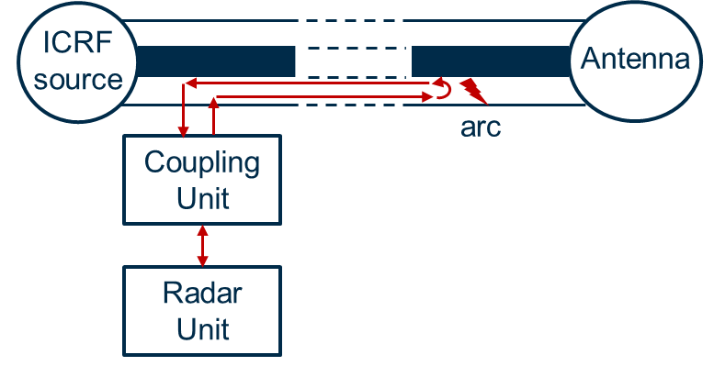
Radar principles
The radar shoots pulses into the Transmission Line (TL).
The pulses travel along the TL being scattered.
When the arc occurs, it creates a strong reflection of the radar signal.
The radar processes echoes to detect, localize, and classify each event (arcs, system degradation)
Notes:
The radar is an active system. Through a dedicated coupling unit installed on the transmission line, the radar sends pulses on the line …

Slide 4
Radar principles
Coupling unit
Transmitted signal generation
Low pass
Correlator
90°
Low pass
Demodulation
Processing
Notes:
The radar I based on a phase modulated signal….
Thumb tac response

Slide 5
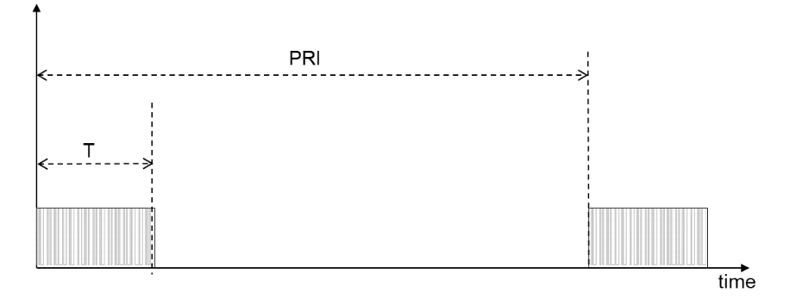
Radar key parameters
Resolution
  Depends on bandwidth
Accuracy
  Depends on sampling frequency
Responsiveness
  Depends on Pulse Repetition Interval (PRI)
Notes:
The responsiveness the ability to react to changes

Slide 6
RADAR parameters
Parameter | Value | Rationale
Carrier frequency | 192 – 240 MHz | Locked to ICRF frequency to suppresses harmonics interference
Bandwidth (Null to Null) | 0.5* Carrier Frequency | Largest bandwidth to stay below the higher order mode
Code type | Golay complementary | Best for noise and interferer suppression
Code length | 64 chips | Allow PRI down to 1 µs (it can be 128 for PRI of 2.5 µs)
Pulse Repetition Interval | Less than 2.5 µs | Secure detection within 5 µs
Sampling frequency | 1 Gsps | Have high localization accuracy
Tx power | 100 W | High power needed due to low DCU coupling

Slide 7
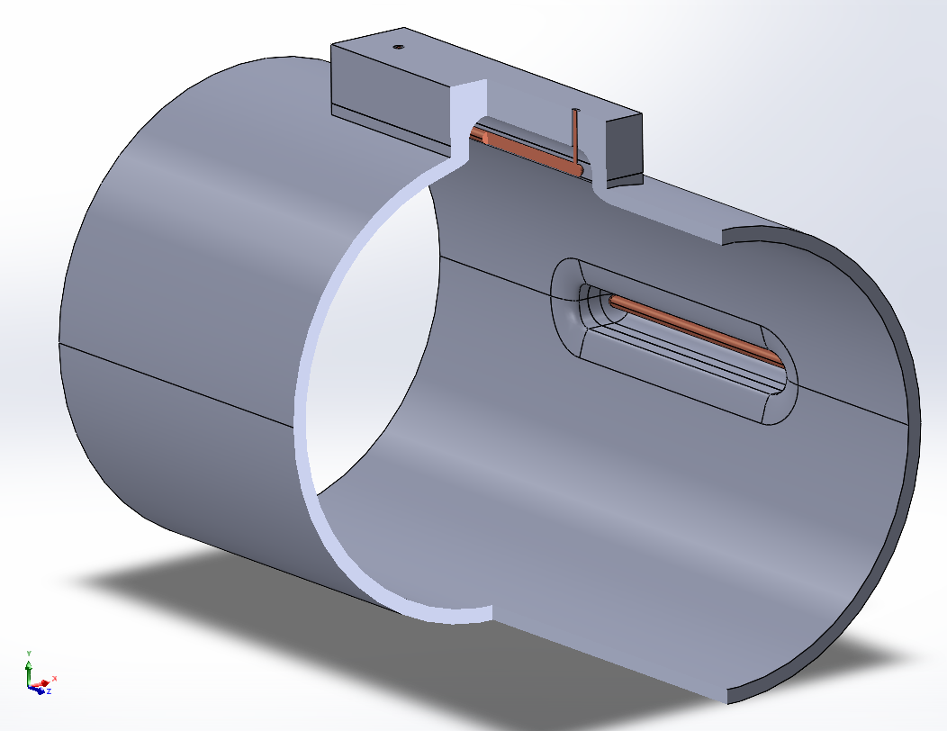
Custom designed dual coupling unit
A custom dual (RX and TX) coupling unit has been designed that does not protrude inside the coaxial and compatible with ITER requirements.
Directional coupler to avoid detection ambiguity, here we seek to protect the antenna side.

Slide 8
Time domain simulations
Closed form components model
Test RAAD during arc transient
Test interferes effects
Full-wave components model
Test detectability of arcs in the components (simulated with and without arcs) of ICRF system
Test cross-coupling between ICRF lines

Slide 9
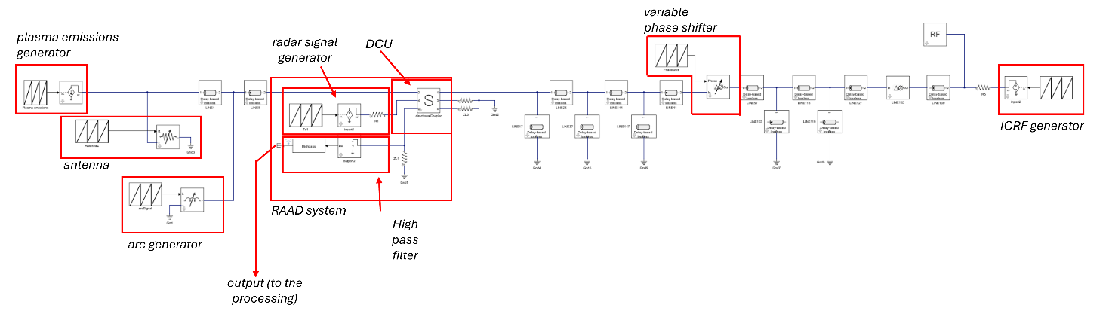
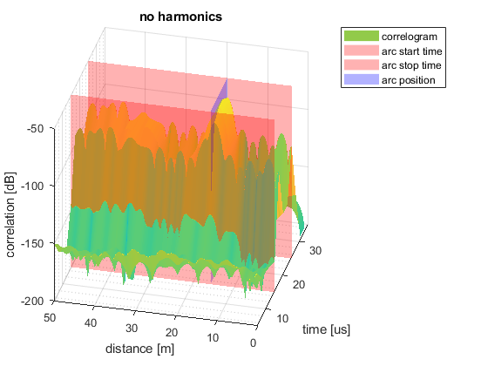
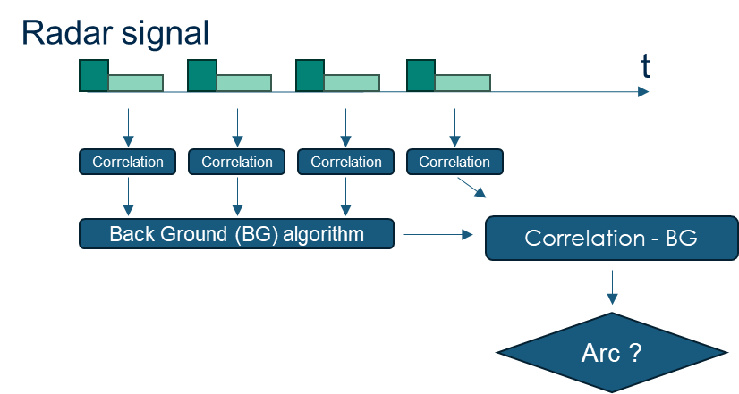
Time domain simulations: closed form model

Slide 10
Dealing with system variations
Two expected time-varying elements:
Plasma loading
  Slow with respect to the Radar PRI (2.5 us)
  Loading variations are included in the background
Matching system
  The matching system is not in the region observed by the radar
  In any case, slow with respect to the PRI

Slide 11
Dealing with plasma emissions
The radar signal is a digitally modulated waveform (Phase Modulated Golay sequence complementary pair)
Wide power spectrum
It is extremely resilient to noise and external interferers

Slide 12
Dealing with ICRF harmonics
ICRF harmonics fall in the radar bandwidth and are stronger than the Rx radar signal.
Solution:
Lock the radar carrier frequency to a multiple of ICRF.
Place complementary pulse start to be on opposite phase of ICRF.
RAAD signal
RAAD
signal
Correlation
Correlation
Final correlation
Notes:
There is a solution we developed..

Slide 13
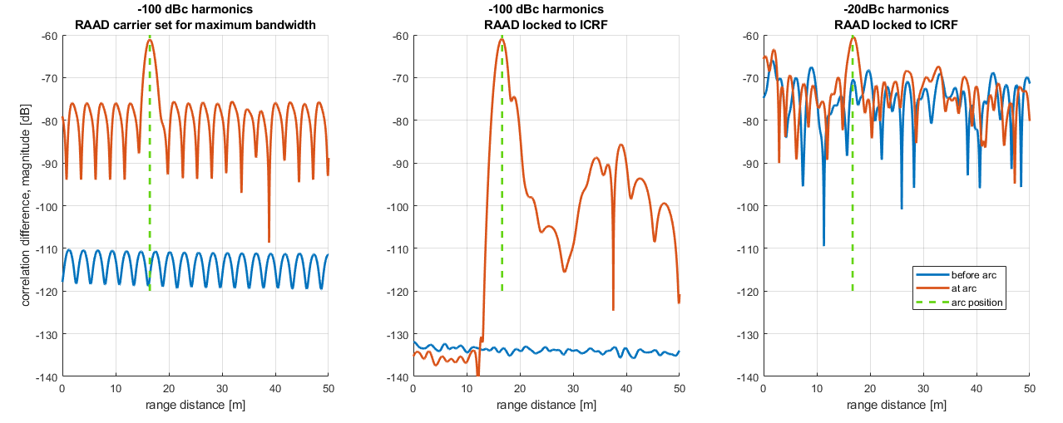
Arc detection example with harmonics suppression
55 MHz ICRF 1 MW, 1 W RAAD
Notes:
3rd 4th harmonic

Slide 14
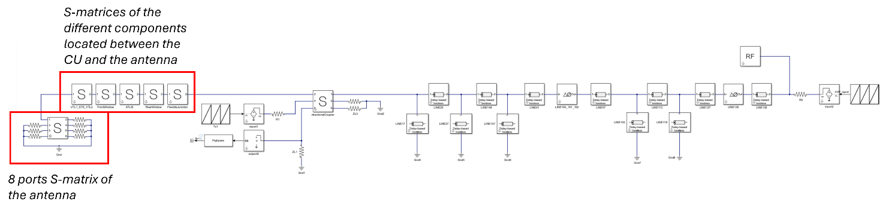
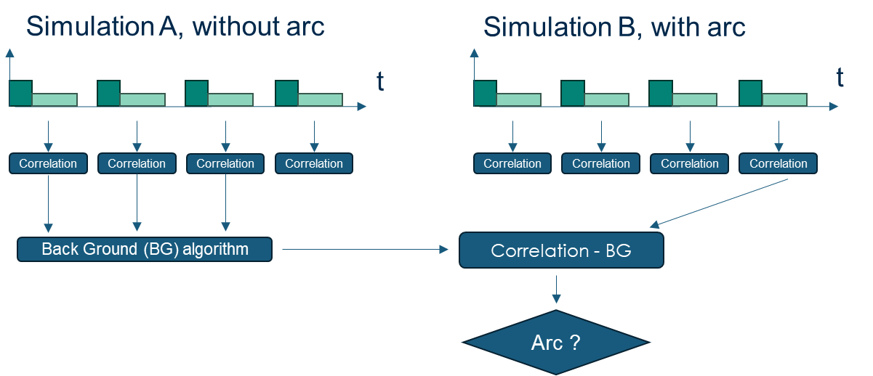
Time domain simulations: full-wave element model

Slide 15
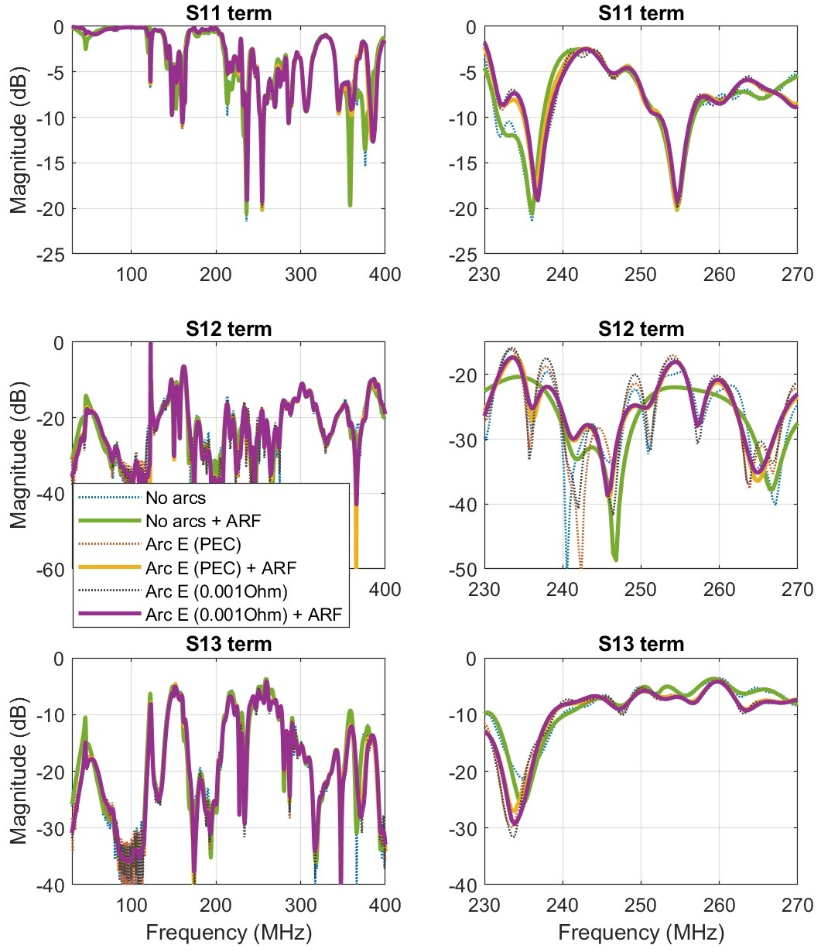
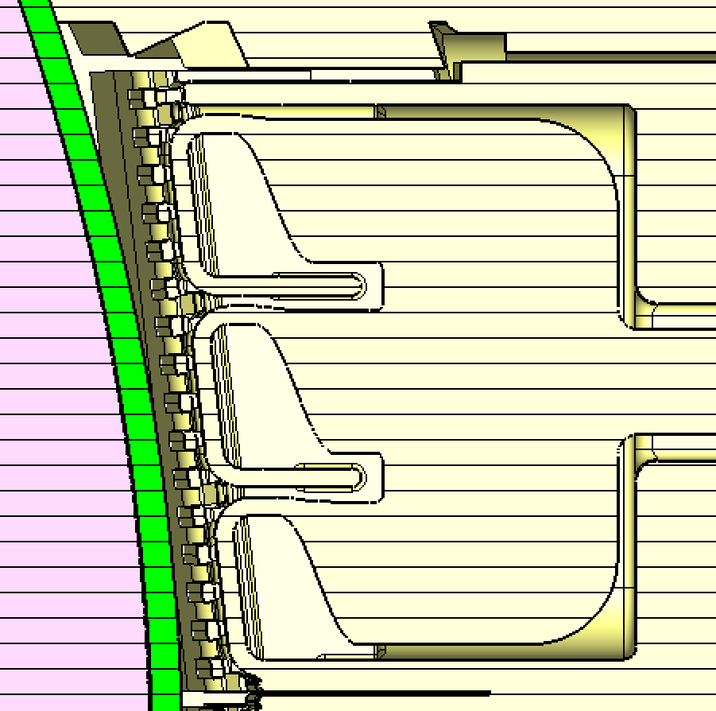
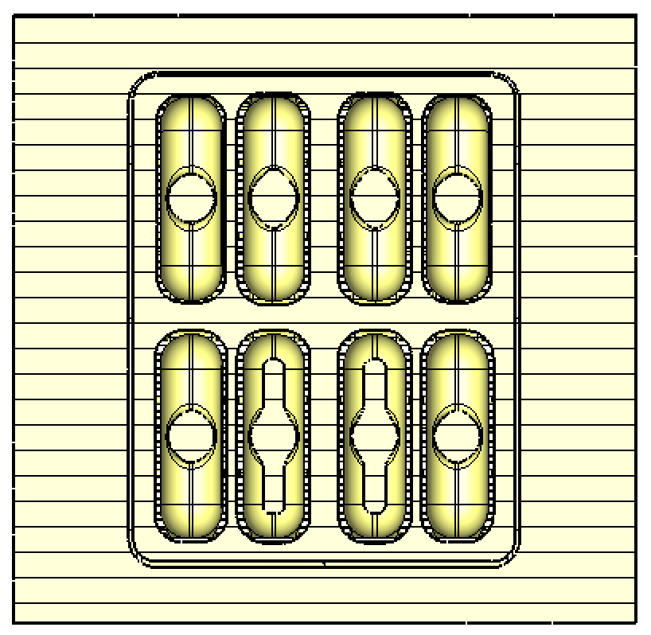
Full-wave simulations of ICRF Antenna at Radar frequency
The ITER ICRF antenna has been simulated at Radar frequency with and without arcs.
The arcs have been modeled with a PEC cylinder and lumped element short.
D
B
E
1 3 5 7
2 4 6 8

Slide 16
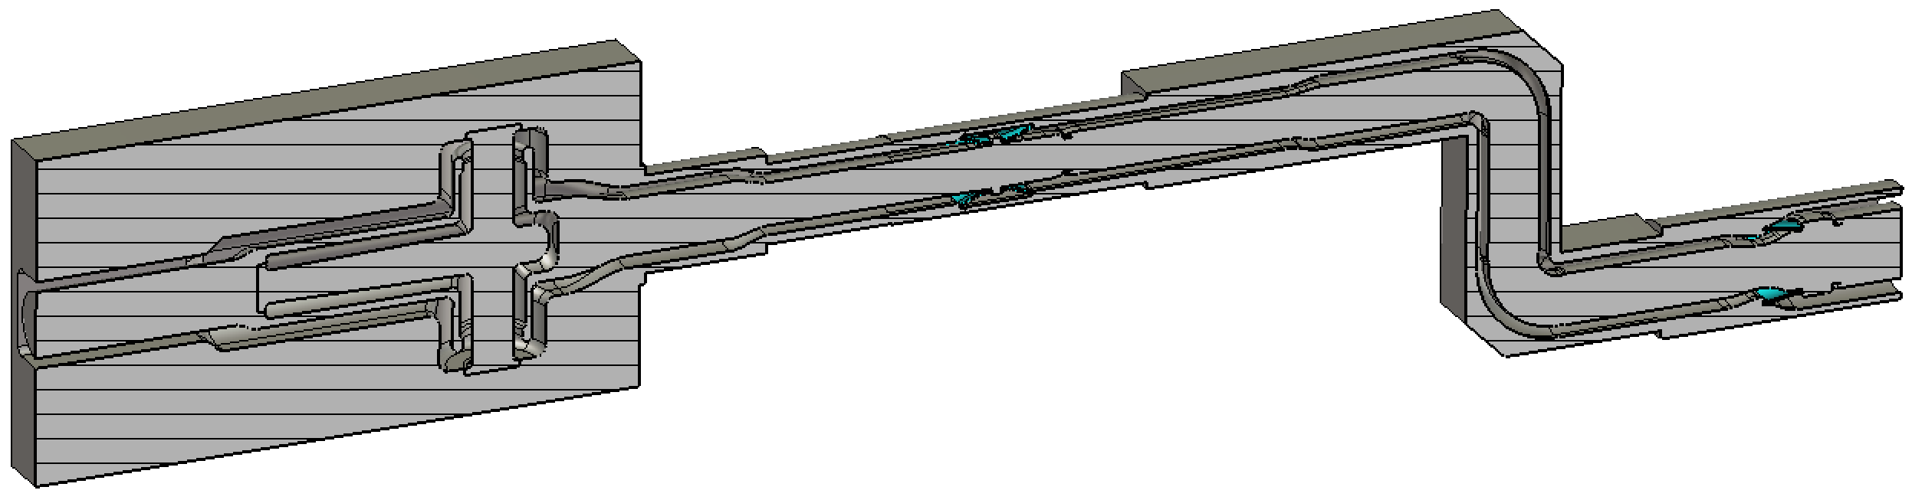
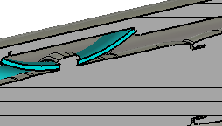
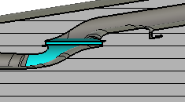
Full-wave simulations of ICRF transmission line components
The Transmission Line (TL) components of the ITER ICRF lines have been simulated at Radar frequency, including arcs (PEC cylinders) and ceramic metallization.
Voltage nodes at 55 MHz
13
20
4
12
19
1
14
21
16
6
7
15
2
5
18
17
3
22
Series arcs
16
Low voltage
12
14
17
13
18
15
Metallization

Slide 17
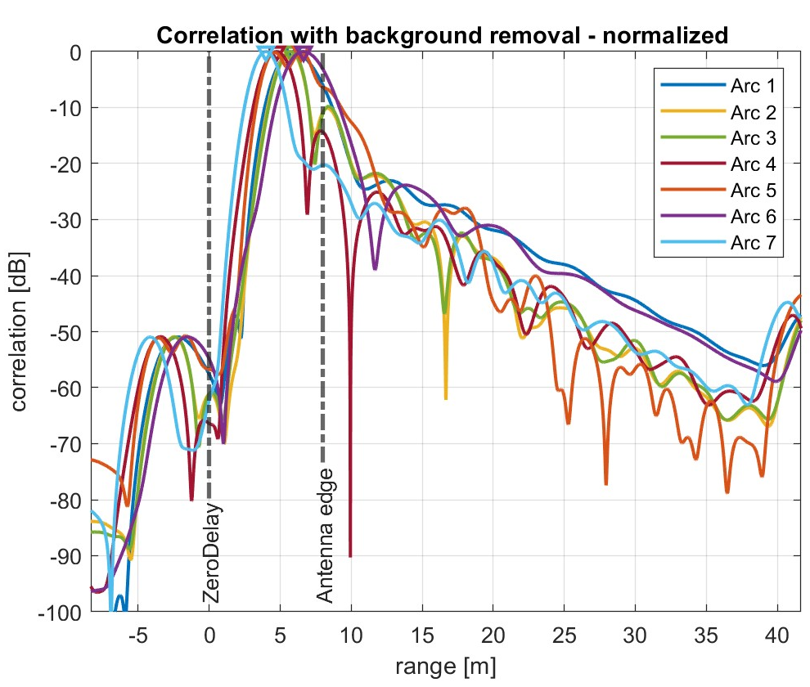
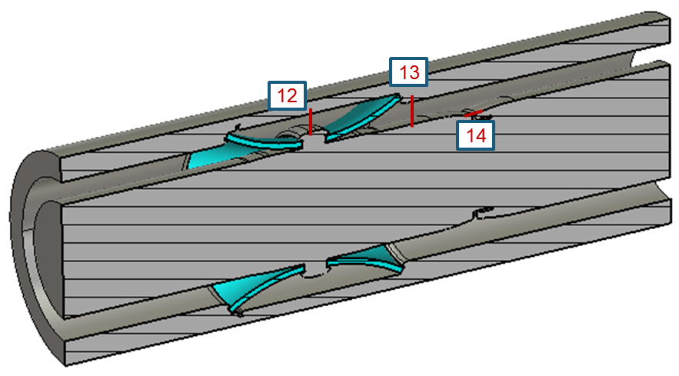
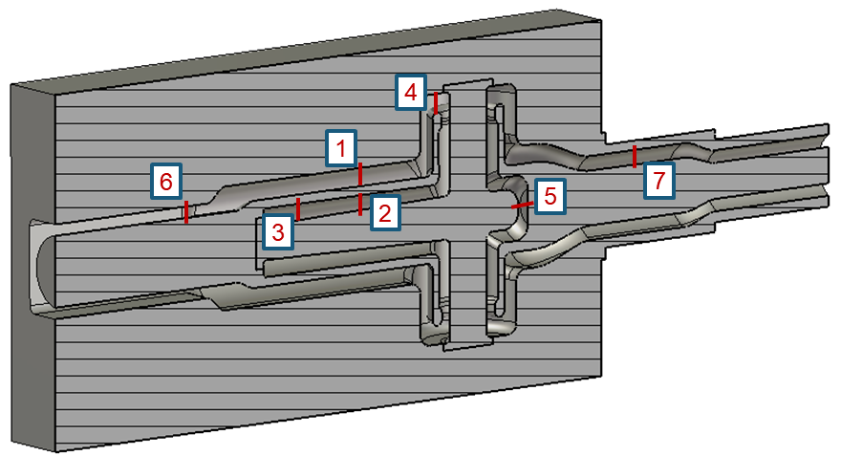
Simulation results – single line system
All arcs detected and localized, including those in low voltage regions.
All impairments detected and localized.

Slide 18
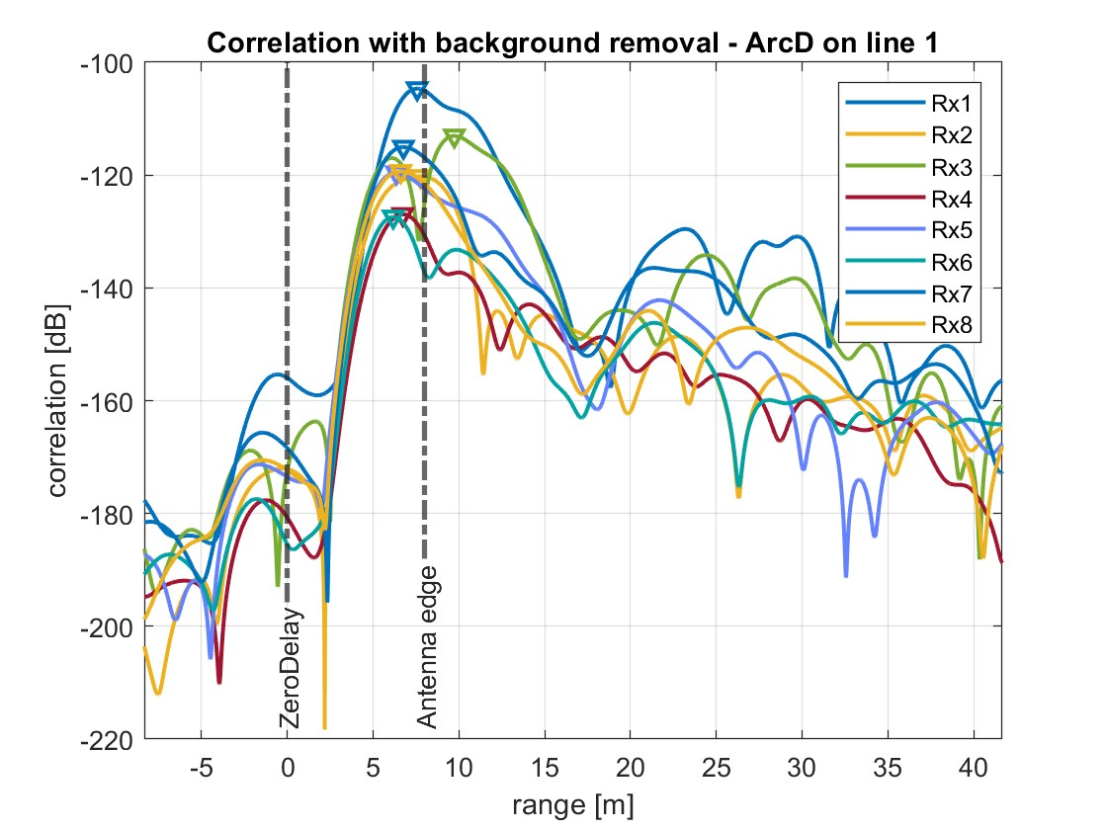
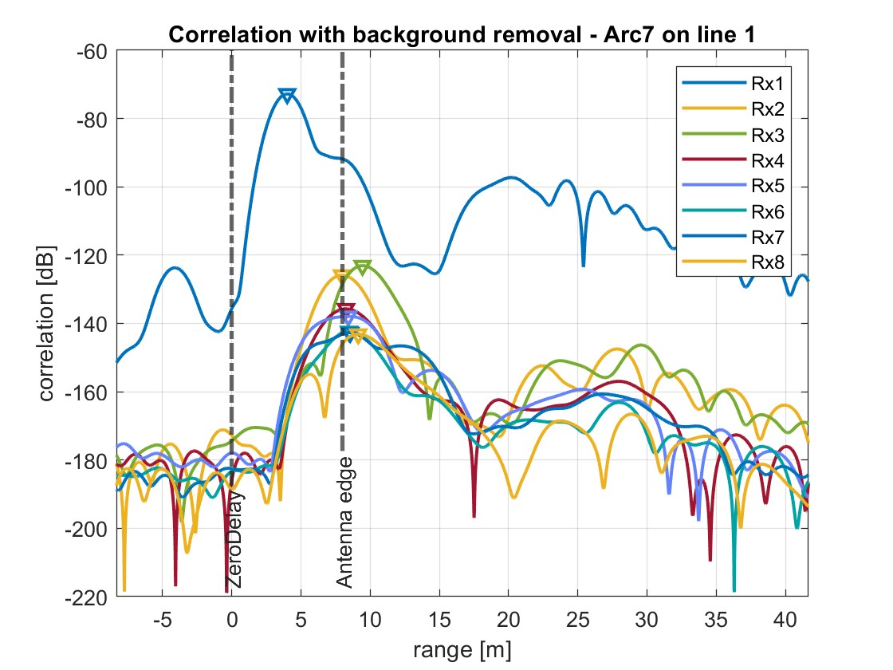
Simulation results – 8 lines ICRF system
Arcs on the antenna influence other lines response
Arcs in the transmission lines do not influence other lines response
1 3 5 7
2 4 6 8

Slide 19
Simulation results
Arc location | RAAD estimated location 8 lines [m] | RAAD estimated location 1 line [m] | Analytically estimated location [m] [7]
Arc E (Antenna) Line 1 | 7.77 | 7.86 | 7.107
Arc D (Antenna) Line 1 | 7.57 | 7.35 | 7.437
Arc B (Antenna) Line 1 | 6.65 | 6.61 | 6.910
Arc 7 (STS) Line 1 | 4.01 | 3.99 | 3.971
Arc 7 (STS) Line 2 | 4.01 | N/A | 3.971
Arc 7 (STS) Line 3 | 4.01 | N/A | 3.971
Arc 7 (STS) Line 5 | 4.01 | N/A | 3.971
Arc 12 (Front Window) Line 1 | 3.66 | 3.65 | 3.392
Arc 19 (ATLIS) | 2.40 | 2.40 | 2.365
Arc 15 (Rear Window) | 1.30 | 1.30 | 1.283
Arc 17 (Rear Window) | 1.19 | 1.21 | 1.022
Arc A (Flexible Junction) | 0.73 | 0.73 | 0.763
Arc B(Antenna) and Arc 7(STS) | 4.01 | N/A | N/A
Arc 1 (STS) and Arc 12 (Front Window) | 3.66 | N/A | 3.392 (Arc 12)
Arc 1 (STS) and Arc 15 (Front Window) | 1.30 | N/A | 1,283 (Arc 15)
Arc B High loading | 6.51 | N/A | 6.910
Arc E Low loading | 7.84 | N/A | 7.107
Arc 7 High loading | 4.01 | N/A | 3.971
Voltage node
Series arc

Slide 20
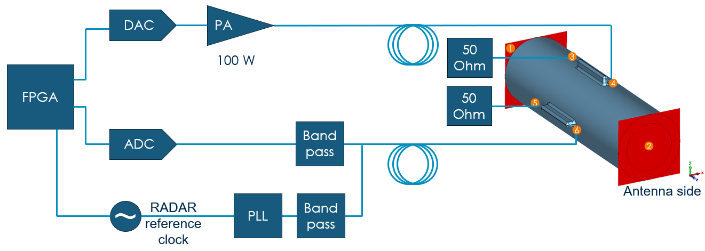
RAAD system block diagram
Software Defined Radar
architecture
Very flexible!

Slide 21
Conclusions: successful proof of principle by modelling.
RAAD can detect arcs within 5 us
RAAD can detect, localize, and classify all arcs everywhere, including low voltage regions
RAAD can detect and localize impairments
RAAD can discriminate arcs from other events
Notes:
If ask question: Multipactor, vacuum arcs, gas discharge

Slide 22
Next step: proof or principle by prototyping and experiments.
Assembly of first prototype and manufacturing of DCU
Testing during plasma operation at AUG (already verified with proper simulation model)
Testing on ITER Prototype Antenna Module under vacuum (already verified with proper simulation model)

