Slide 1
The ITER ICRF system under the new ITER baseline: latest updates and technological developments
W. Helou, F. Calarco, N. Ferrigno, F. Kazarian, K. Saito, V. Bobkov, L. Colas, P. Dumortier, F. Durodié, E. Lerche, R. Maggiora, D. Milanesio, S. Porporato, S. Salvador, M. Schneider, R. Anand, J. Appanam Karakkad, H. Aubert, C. Barbier, P. Barges, B. Beaumont, M. Bécoulet, J.-M. Bernard, N. Bertelli, A. Bustos, A. Cadinot, H. Faugel, N. Faure, R. Goulding, M. Graham, D. Guillermain, J. Hillairet, P. Jacquet, J. Jacquinot, A. Jha, A. Kaye, F. Koechl, A. Krivska, A. Kumar, R. Kumar, P. Lamalle, A. Loarte, G. Lombard, F. Louche, V. Maquet, I. Minondo, P. Mollard, I. Monakhov, A. Mukherjee, J. Myra, R. Ochoukov, A. Patel, M. Patel, R. Pitts, C. Qin, S. Shiraiwa, R. Singh, G. Suthar, W. Tierens, R. Trivedi, G. Urbanczyk, M. Usoltseva, D. Van Eester, Y. Wang, T. Wauters, Z. Wolfe, H. Yang, W. Zhang, and X. Zhang.
Disclaimer: The views and opinions expressed herein do not necessarily reflect those of the ITER Organization

Slide 2




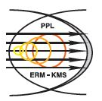







Acknowledgments

Slide 3
Outline
ITER ICRF system under the new ITER Research Plan (IRP).
ICRH scenarios.
Ion Cyclotron Wall Conditioning (ICWC).
Coupling and local gas injection modelling.
ICRF specific sputtering predictions under W-wall.
Full system RF modelling.
Antenna RF and mechanical design activities.
Antenna protections and arc detection.
Prototyping activities.
Conclusion and timeline.

Slide 4
Outline
ITER ICRF system under the new ITER Research Plan (IRP).
ICRH scenarios.
Ion Cyclotron Wall Conditioning (ICWC).
Coupling and local gas injection modelling.
ICRF specific sputtering predictions under W-wall.
Full system RF modelling.
Antenna RF and mechanical design activities.
Antenna protections and arc detection.
Prototyping activities.
Conclusion and timeline.

Slide 5
Outline
ITER ICRF system under the new ITER Research Plan (IRP).
ICRH scenarios.
Ion Cyclotron Wall Conditioning (ICWC).
Coupling and local gas injection modelling.
ICRF specific sputtering predictions under W-wall.
Full system RF modelling.
Antenna RF and mechanical design activities.
Antenna protections and arc detection.
Prototyping activities.
Conclusion and timeline.

Slide 6
Heating & Current Drive (HCD) under the new IRP
New baseline: change of First Wall material from Be to W.
→Modified Heating and Current Drive (H&CD) strategy:​
Electron Cyclotron Heating (ECH) increased by factor 2-3 (40-67 MW​).
Ion Cyclotron Heating (ICH) set to 10-20 MW​.
10 MW for the Start of Research Operation (SRO) for ICWC and tests of ICH under high-Z wall.
Rationale behind the new H&CD mix:​
Dominant ECH to overcome the increased W source.
More H&CD power to reduce need for fusion alphas in development path to Q=10 (limited neutron budget in DT-1)​.
[M. Schneider, et al., this conf.]

Slide 7
Basis of the new HCD level and mix
# | Task / Target | Heating mix consideration
1 | Enable H-mode operation in SRO. | 40 MW of ECRH.
2 | ICRH operation in full W wall: tests of ICRH coupling & ICRF-specific sputtering. | 10 MW ICRF system to be experimentally validated in SRO before any upgrade to 20 MW for DT-1.
3 | Tests of fuel removal in SRO (ICWC).
4 | Enable DD H-mode development to high I_{p} in DT-1. | 33 MW NBI. 60-67 MW ECRH.
5 | Enable access to high Q for P_{rad}/P_{tot} > 0.3.
6 | Enable Q=5 steady state operation for DT-2. | HNB-3.

Slide 8
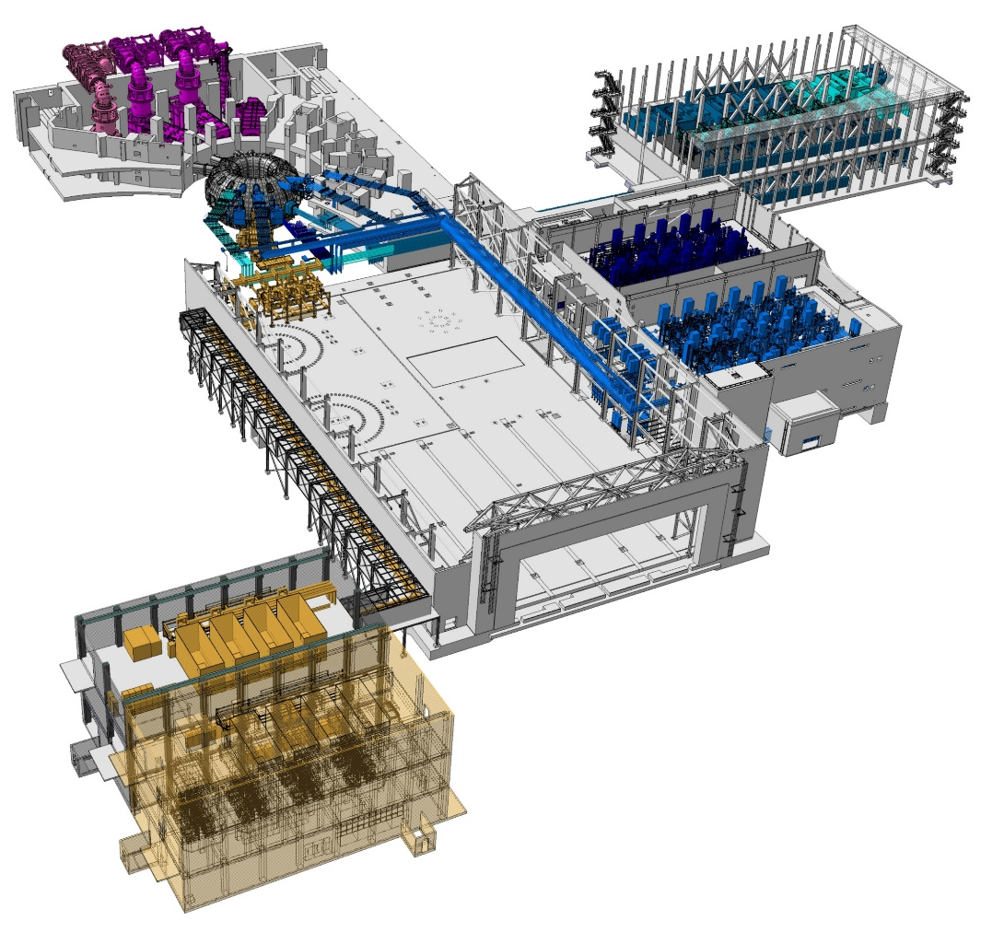
HCD mix in SRO, DT-1 and DT-2
HNB installed power of 33MW
ECRF upgrade up to 67MW
ECRF installed power of 60MW in DT-1
HNB3 upgrade
ICRF power of 10MW in SRO
ECRF installed power of 40MW in SRO
ICRF upgrade to 20 MW

Slide 9
Scenario development pathway in SRO and DT-1
Use of W wall favours B_{T} values that provide effective central heating.
→ Scenario development at 2.65 and 5.3 T.
 | SRO |  | DT-1
ECRF | 40 MW | 2.65 T X2 in L-mode, O2 in H-mode. | 60-67 MW | 2.65 T X2 in L-mode, O2 in H-mode.
 |  | 5.30 T O1. |  | 5.30 T O1.
ICRF | 10 MW | 2.65 T In D at ~42 MHz: H minority (N=1), or, D majority (N=2). In H: No efficient scheme. | 10-20 MW | 2.65 T In D and DT at ~42 MHz: H minority (N=1), or, D majority (N=2). in H: No efficient scheme.
 |  | 5.30 T In D or H at ~53 MHz: ³He minority (N=1). |  | 5.30 T In D or H at ~53 MHz: ³He minority (N=1). In DT at ~53 MHz: ³He minority (N=1), T majority (N=2).
NBI |  |  | 33 MW | Up to 0.87 MeV H beams. Up to 1.00 MeV D beams.
Assess coupling & ICRF-specific sputtering.

Slide 10
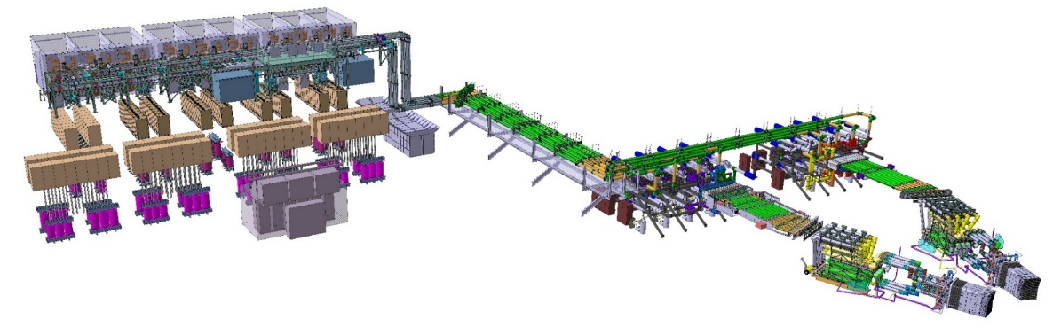


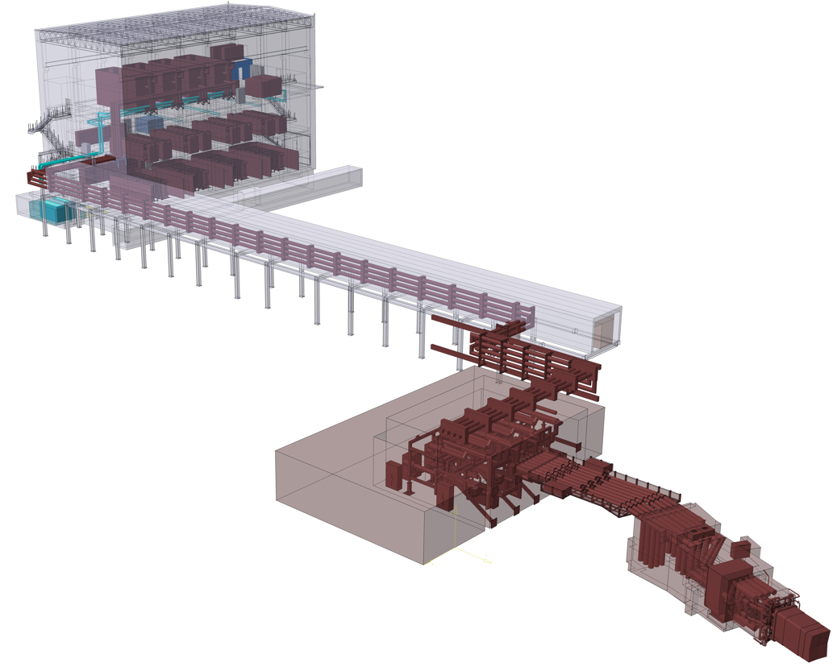
ITER ICRF system under the new IRP
8+1 RF sources
and their HVPS
2016 baseline
8 Transmission Lines
ICWC/ICRH with 10MW for SRO:
No technical requirements modified for the individual components of the ICRF system.
New location for the RF sources & HVPS (B15N allocated to ECRF).
1 antenna (instead of 2, second port allocated to ECRF).
The system is compatible with ICWC (needing 2-2.5 MW coupled to plasma → 5 MW installed). 10 MW installed power relaxes constraints on ICWC and allows proper testing of ICRH.
The system is upgradable to 20 MW.
2 antennas
4 RF sources and their HVPS
2.5 MW @ VSWR 2:1, 35-65 MHz, CW
3.0 MW @ VSWR 1.5:1, 40-55 MHz, CW
4 Transmission Lines
2024 baseline for SRO
1 antenna

Slide 11
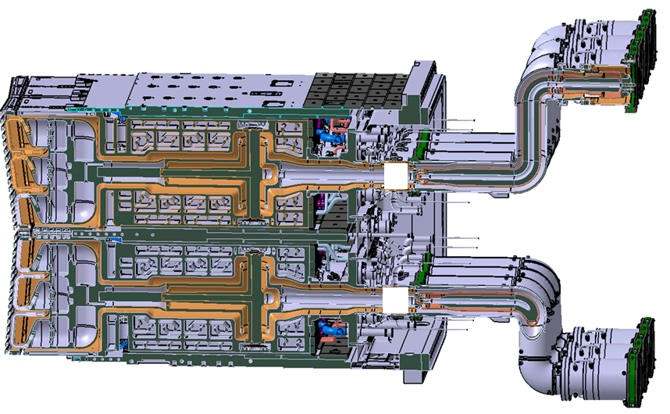
The ITER ICRF antenna
Vacuum Transmission Line (oblong shaped)
Service T-stub
Strap
Rear Window
ATLIS (6 bar dry air)
Faraday Screen
Front Window
(double barrier)
Four Port Junction
45 kV peak nominal voltage.
E_{max}=2-3 kV/mm (depending on direction, and location).
Optimized for 40-55 MHz.
10 MW CW, compatible with 20 MW CW.
RF modules designed to maximize coupled power + provide neutron shielding and compliance to multiphysics requirements.
3.5 m × 2.0 m × 1.5 m, 45 tons.
24 straps array grouped in 8 triplets.
8 inputs. Flexibility for antenna array excitation.
4 RF modules.

Slide 12
Outline
ITER ICRF system under the new ITER Research Plan (IRP).
ICRH scenarios.
Ion Cyclotron Wall Conditioning (ICWC).
Coupling and local gas injection modelling.
ICRF specific sputtering predictions under W-wall.
Full system RF modelling.
Antenna RF and mechanical design activities.
Antenna protections and arc detection.
Prototyping activities.
Conclusion and timeline.
Acknowledgments: M. Schneider, E. Lerche, F. Koechl, et al.
[E. Lerche, et al., this conf.]

Slide 13
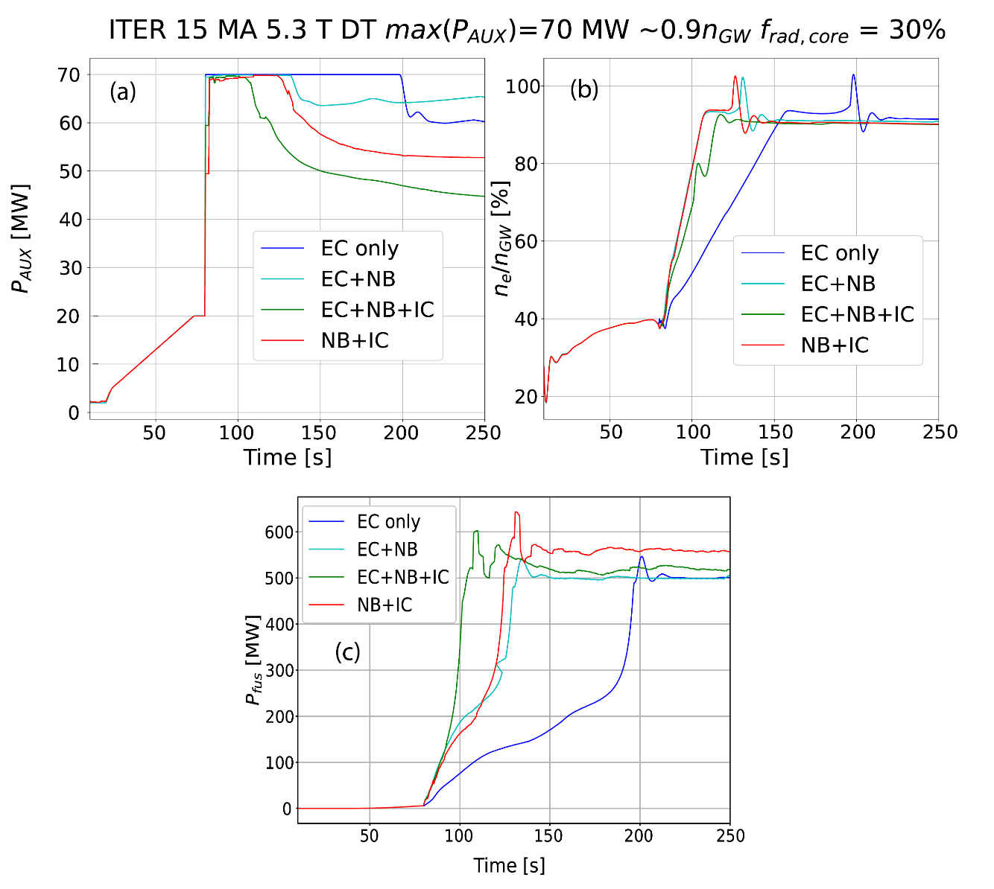
Effect of ICH on fusion performance
Waveforms of H&CD power and plasma density to access Q ~ 10 conditions for a range of H&CD mixes (assuming P_{rad} = 30%):
For each case: the temporal evolution of density corresponds to the fastest density rise to achieve Q=10 (if too fast → H-L transition → T_{i} drops → P_{α} drops).
Slower density rise with only ECH).
Faster access to burning plasma conditions and increased fusion power with direct ion heating (NBI and ICH).
Such scenarios can be tested end of DT-1 or in DT-2.
Shot=53301, Runs 80 to 84.
[A. Loarte et al., “The new ITER Baseline, Research Plan and open R&D issues”, accepted to PPCF (2025)]

Slide 14
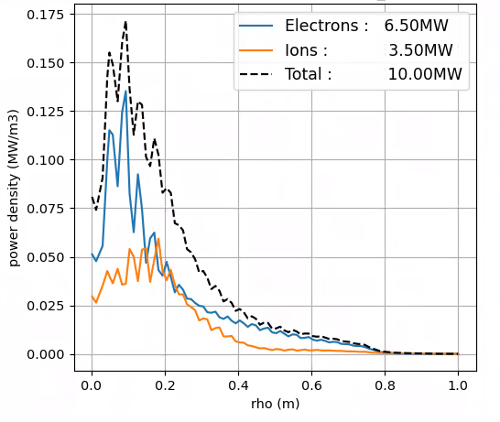
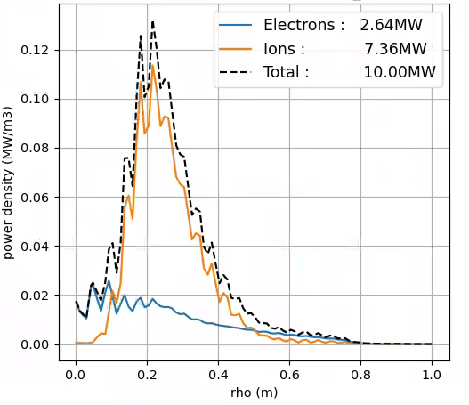
SRO: Ion heating in D plasmas with ICH [1/2]
On-axis H min. (2.65T/42MHz)
Off-axis H min. (2.65T/40MHz)
2%H
0.3%H
(residual)
Bulk ion heating with H min. ICRH can be obtained by:
- Shifting the resonance off-axis (reducing the frequency).
- No H₂ injection to enhance ω=2ω_{c} D absorption.

Slide 15
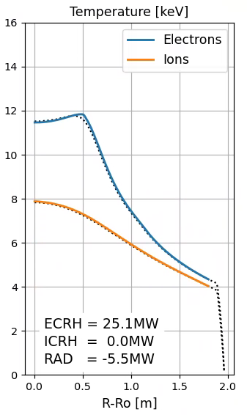
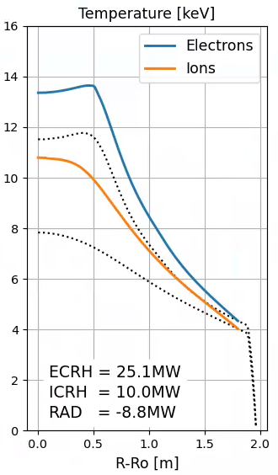
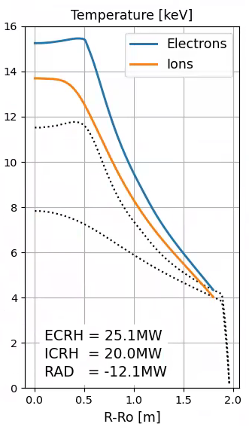
SRO: Ion heating in D plasmas with ICH [2/2]
Best ICRF settings for ion heating at 2.65T (L-mode):
n_{e0}=4.7x10¹⁹/m³, T_{e0}=12keV, T_{i0}=8keV
ECRH=25MW
ICRH=0 (ref.)
ICRH=10MW
ICRH=20MW
T_{i} <~ T_{e}
ICRH increases T_{i} efficiently.
T_{i}>T_{e} regime not reached with ECRH = 25MW; could require more than 20 MW ICRH or reducing ECRH power.

Slide 16
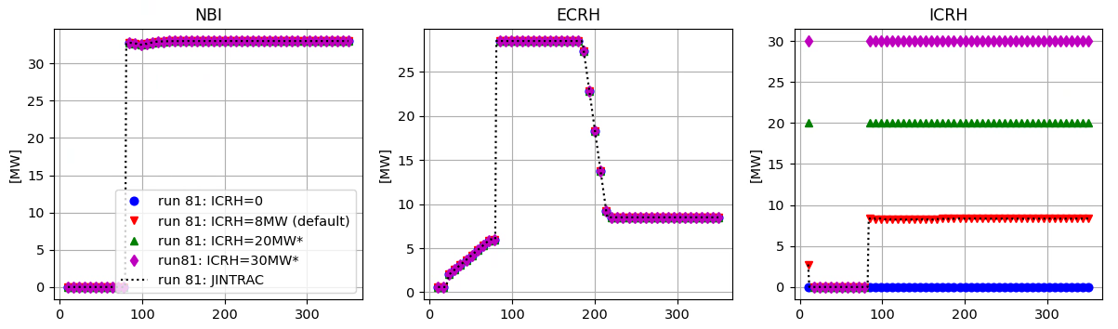
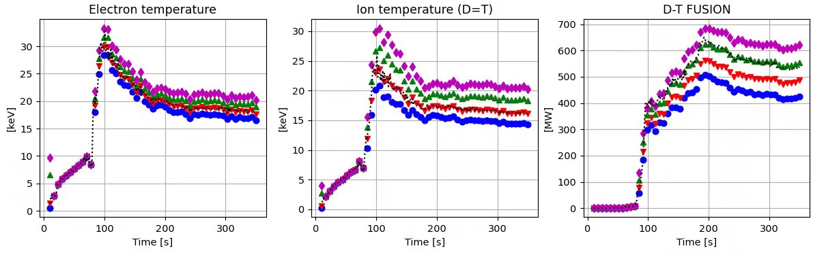
D-T: Effect of ICH power on fusion performance [1/2]
ICRH: ³He / T heating in D-T H-mode plasmas (5.3 T / 15MA) - simpletransp
30MW
20MW
8MW
0MW
ΔT_{i} = 5keV
ΔP_{fus} = 200MW
ICRH can have a strong impact on T_{i} and on fusion power but 10 MW can be marginal.
For 20MW: ΔT_{i}=4keV, ΔP_{fus}=120MW

Slide 17
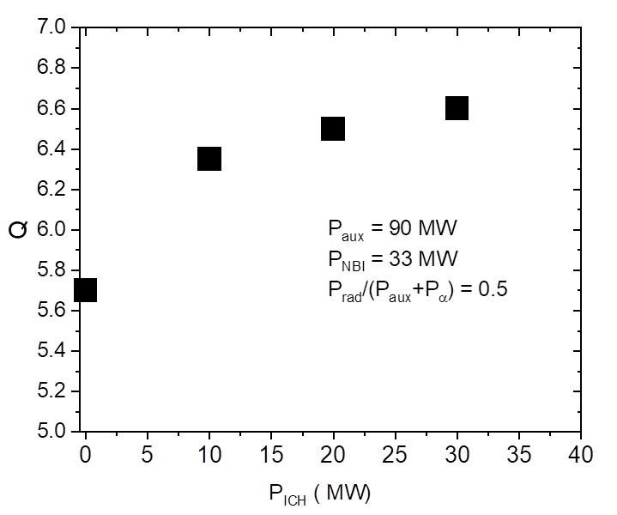
D-T: Effect of ICH power on fusion performance [2/2]
Very clear effect on Q but then this saturates because ion temperature gradient hits stiffness limits and fusion power doses not go up much more with more ion heating.
Will be complemented by:
Scan extension to 40 MW of ICH, also case with 50 MW ECH and 40 MW ICH for comparison.

Slide 18
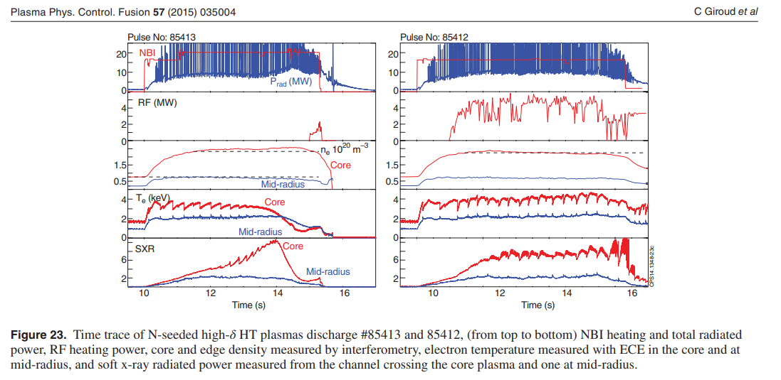
High ICH power key for stationarity in seeded plasmas
Same behaviour is observed in JET Ar and Ne seeded plasmas.

Slide 19
Outline
ITER ICRF system under the new ITER Research Plan (IRP).
ICRH scenarios.
Ion Cyclotron Wall Conditioning (ICWC).
Coupling and local gas injection modelling.
ICRF specific sputtering predictions under W-wall.
Full system RF modelling.
Antenna RF and mechanical design activities.
Antenna protections and arc detection.
Prototyping activities.
Conclusion and timeline.
Acknowledgments:
T. Wauters, et al.

Slide 20
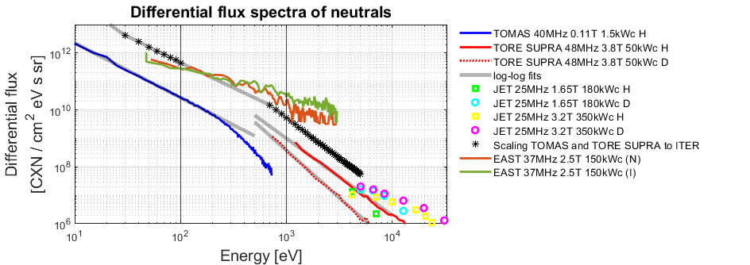
ICWC [1/2]
Uniform CXN flux of 6 – 8 x10¹⁸ D m⁻²s⁻¹ in 0.1 - 1 keV range, based on:
  TOMAS and TORE SUPRA fluxes scaled to ITER power / surface area.
  Recent EAST LENPA data at ITER relevant power / surface area.
20 to 30 min ICWC in ITER (P_{ICWC} ~2 MW) at 15% duty cycle sufficient to deplete near surface layers of W and B, for effective plasma isotope control.
EAST joint exp. 2024
High implantation energy while maintaining long mean free path for CXN collisions to obtain a toroidally uniform flux

Slide 21
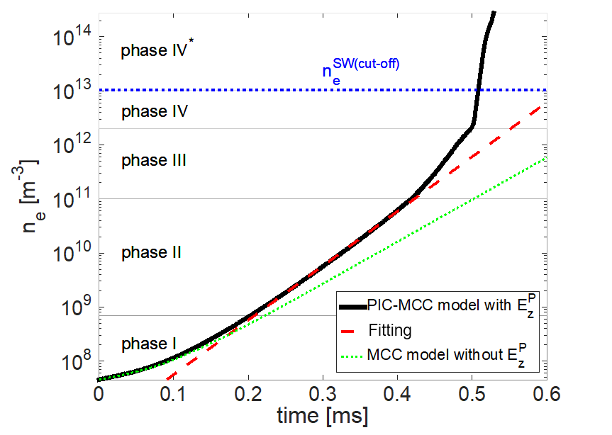



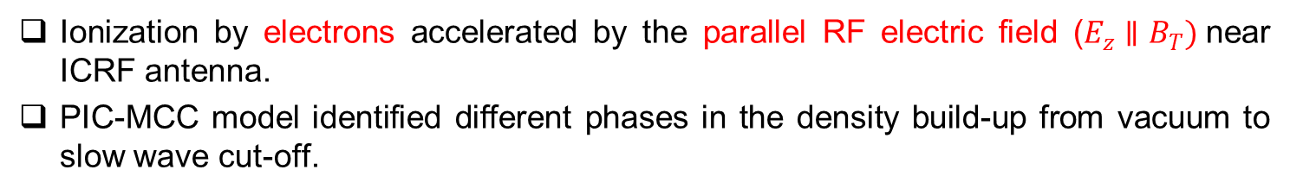
ICWC [2/2]
Ionization by electrons accelerated by the parallel RF electric field ($E_{z}∥B_{T})$near ICRF antenna.
PIC-MCC model identified different phases in the density build-up from vacuum to slow wave cut-off.
[Tripsky, et al., NF 2017]
Plasma density evolution by Rfdinity-1D:
Plasma-generated electrostatic field
$$\left|E_{z,P}\right|≈\left|E_{z,RF}\right|$$
Challenges for ITER ICRF breakdown:
Antenna launches mainly E⊥.
ITER ICRF at 40-55 MHz, but breakdown suspected to be easier at low frequency (TBC).
Large torus circumference C: ionization rate (∝ 1/C).
$$\left|E_{z,P}\right|<\left|E_{z,RF}\right|$$
$$\left|E_{z,P}\right|≪\left|E_{z,RF}\right|$$
Vacuum electric field
f = 29 MHz, p_{H2} = 4×10⁻⁴ mbar, ASDEX Upgrade sized device

Slide 22
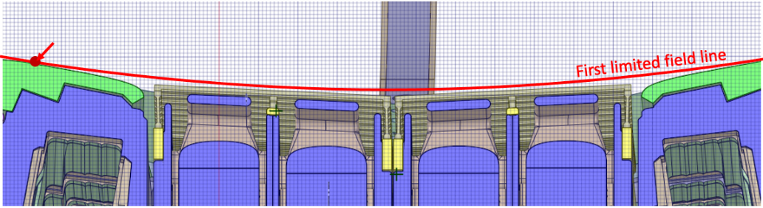
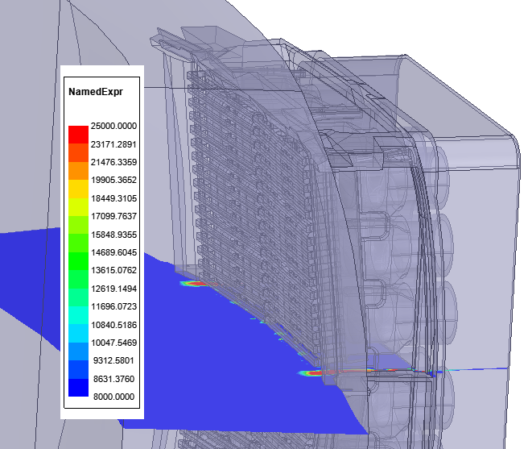
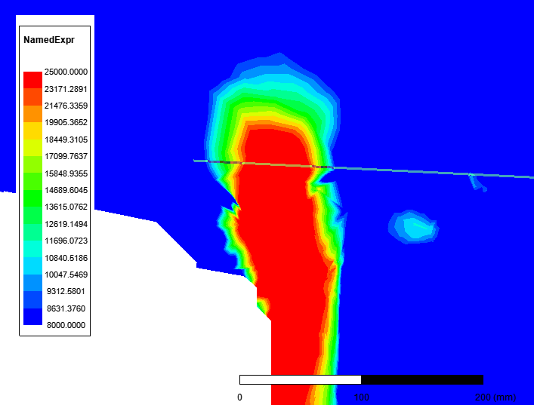
IC breakdown phase
Required field for IC breakdown @ 40 MHz in ITER, based on 1D simulation:
|E//| > 8 kV/m at spots with at least ~50mm spatial extensions inside the first limited field line.
Modelled |E//| in vacuum, 45 kV peak, 40 MHz, monopole
[V/m]
[V/m]
100 mm
FS CMM
Criterion fulfilled but verification needed in 3D Monte Carlo simulation.

Slide 23
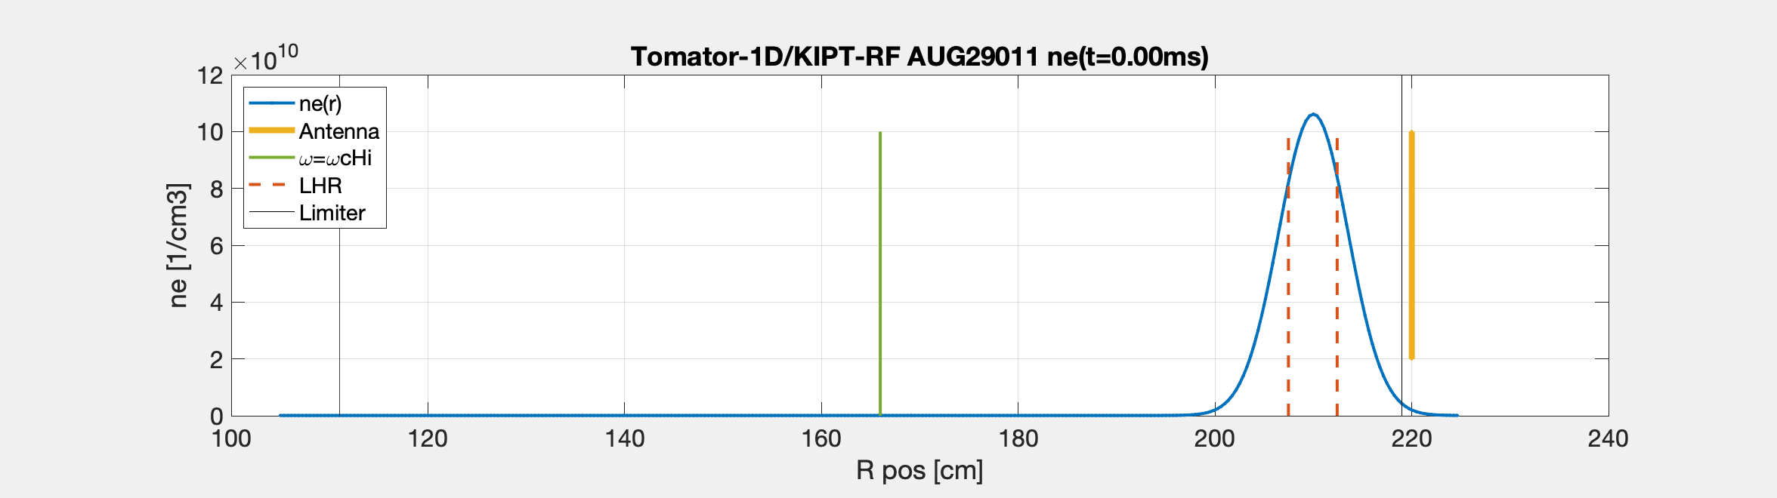
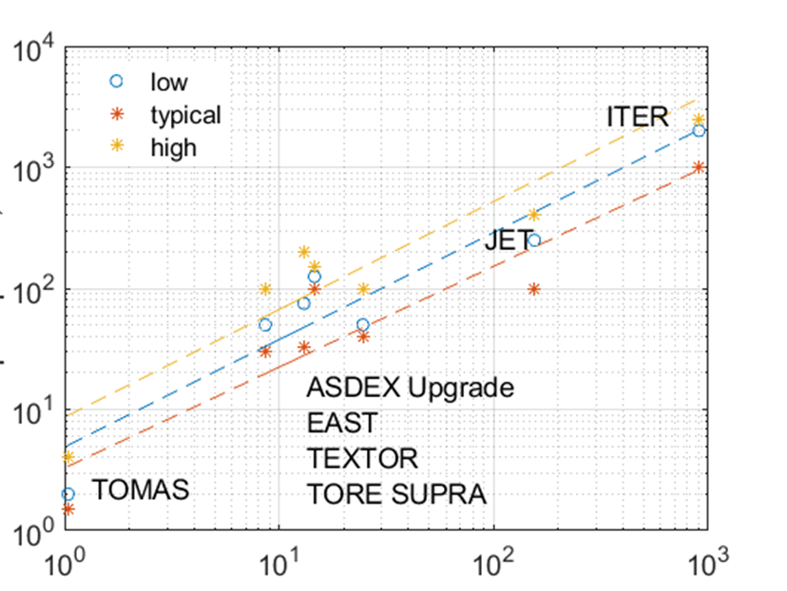

Steady ICH phase [1/3]
Uniform discharge produced by non-resonant damping on ions and electrons. Coupling resistance and radial expansion result from appearance of LHR.
Tomator-1D/KIPT-RF
$ω=ω_{c,H^{+}}$
2 antennas
In monopole
LHR
2.0-2.5 MW coupled to plasma (volumetric power scaling from JET with 100-200 kW). At 40-50% efficiency → 5 MW source power.
P_{coupled} [kW]
Volume [m³]

Slide 24
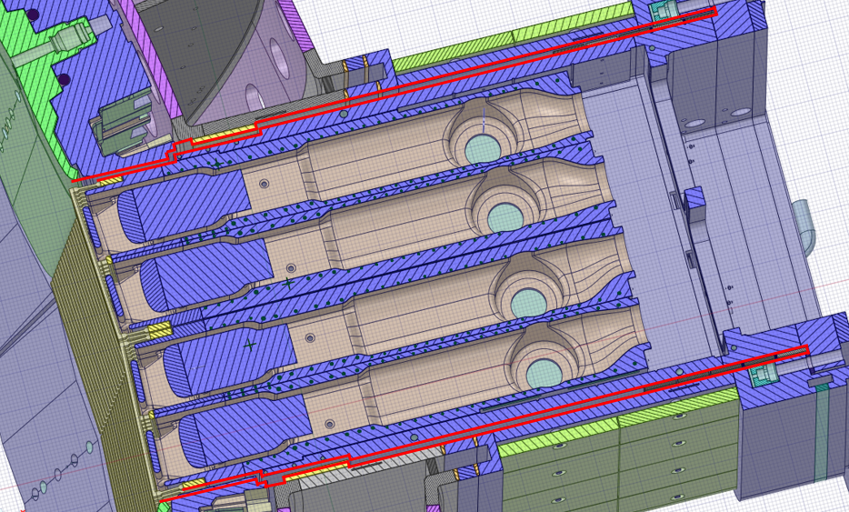
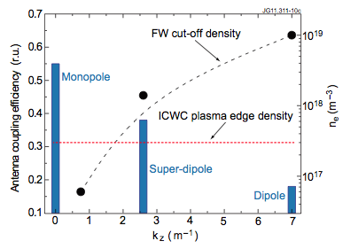
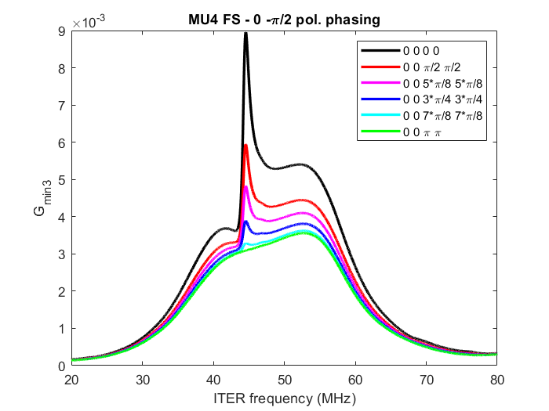
Steady ICH phase [2/3]
Decreasing cut off density for fast wave propagation improves RF coupling and discharge homogeneity → Monopole (note: cavity mode at ~47.5 MHz).
RF cavity in red
Best coupling expected for [0;0;0;0] phasing
[0;0;φ;φ] phasing, with φ ≠ π.
[F. Louche, et al., this conf.]
[A. Krivska, et al. this conf.]

Slide 25
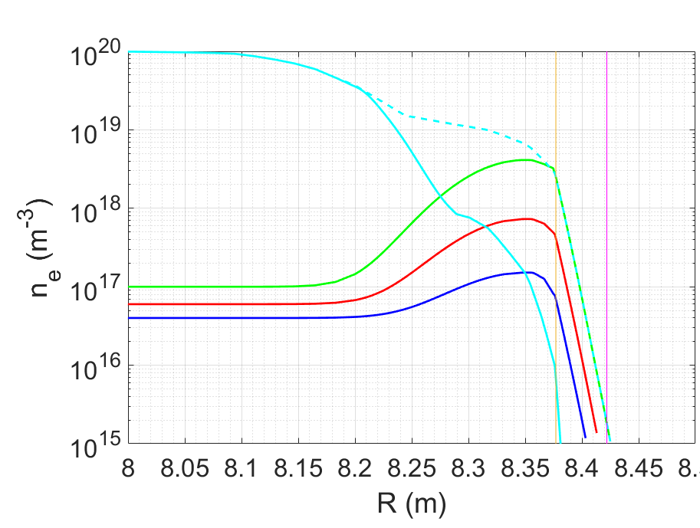
Steady ICH phase [3/3]
ANTITER IV modelling (Fast and Slow Waves) :
ICWC LOW | [0;0;0;0] | [0;0;+π/2;+π/2] | [0;0;π;π]
40 MHz | 40.2 kV / 2.0 MW | 45.0 kV / 1.4 MW | 45 kV / 0.2 MW
53 MHz | 22.5 kV / 2.0 MW | 30.5 kV / 2.0 MW | 45 kV / 0.7 MW
Color code
OK, OK
0.5 MW < P_{ICWC} < 1 MW
P_{ICWC} < 0.5 MW
ICWC Interm. | [0;0;0;0] | [0;0;+π/2;+π/2] | [0;0;π;π]
40 MHz | 30.6 kV / 2.0 MW | 41.5 kV / 2.0 MW | 45 kV / 0.4 MW
53 MHz | 16.7 kV / 2.0 MW | 22.4 kV / 2.0 MW | 45 kV / 1.6 MW
ICWC High | [0;0;0;0] | [0;0;+π/2;+π/2] | [0;0;π;π]
40 MHz | 8.9 kV / 2.0 MW | 11.4 kV / 2.0 MW | 19.5 kV / 2.0 MW
53 MHz | 3.7 kV / 2.0 MW | 4.6 kV / 2.0 MW | 6.4 kV / 2.0 MW
3 ICWC density profiles for sensitivity analysis
Straps
For most cases, the antenna can deliver the required power for ICWC.
High.
Intermediate.
Low.
Wall

Slide 26
Outline
ITER ICRF system under the new ITER Research Plan (IRP).
ICRH scenarios.
Ion Cyclotron Wall Conditioning (ICWC).
Coupling and local gas injection modelling.
ICRF specific sputtering predictions under W-wall.
Full system RF modelling.
Antenna RF and mechanical design activities.
Antenna protections and arc detection.
Prototyping activities.
Conclusion and timeline.

Slide 27
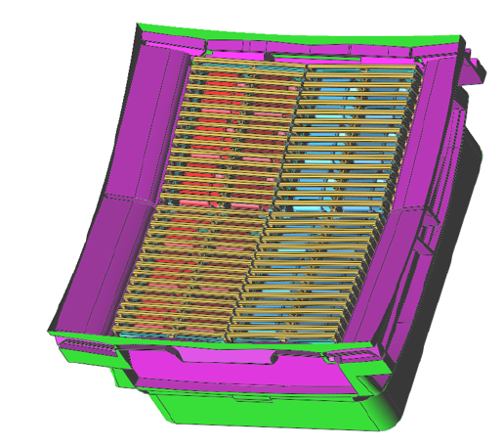
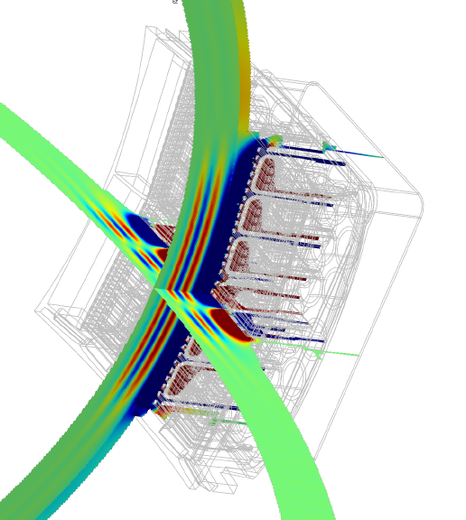
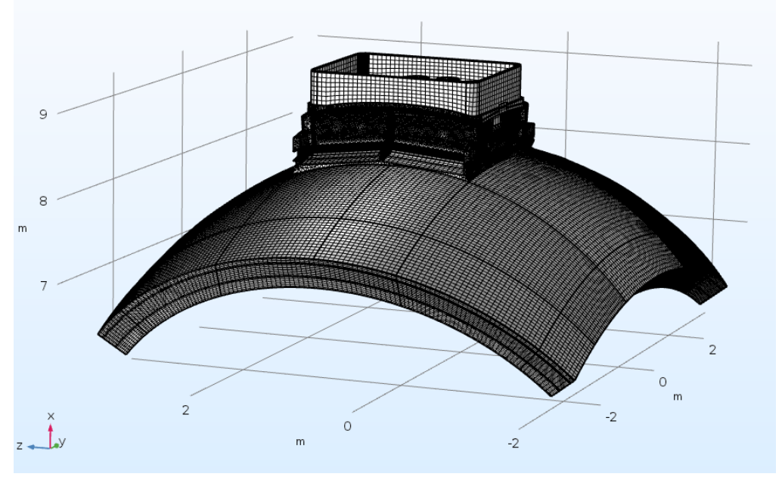
Thorough RF coupling modelling
Modelling in: TOPICA, COMSOL (RAPLICASOL), Petra-M, HFSS, MWS, ANTITER II & IV.
Benchmarks essential as per Quality Assurance.
Served for solid demonstration of system RF design, gas injection performance, operation strategies (optimized excitations, etc.), coupling capabilities, etc.
[Milanesio, et al., RFPPC 2022]
[Bertelli, et al., RFPPC 2022]
[Milanesio, et al., NF 2023]
Examples:
TOPICA
Petra-M
COMSOL(RAPLICASOL)

Slide 28
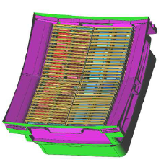
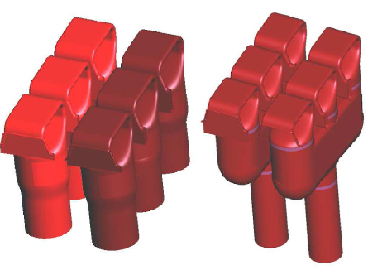
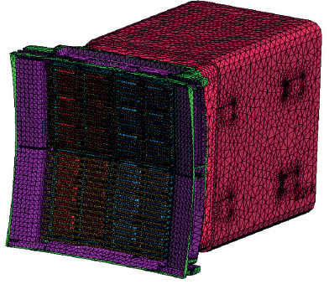
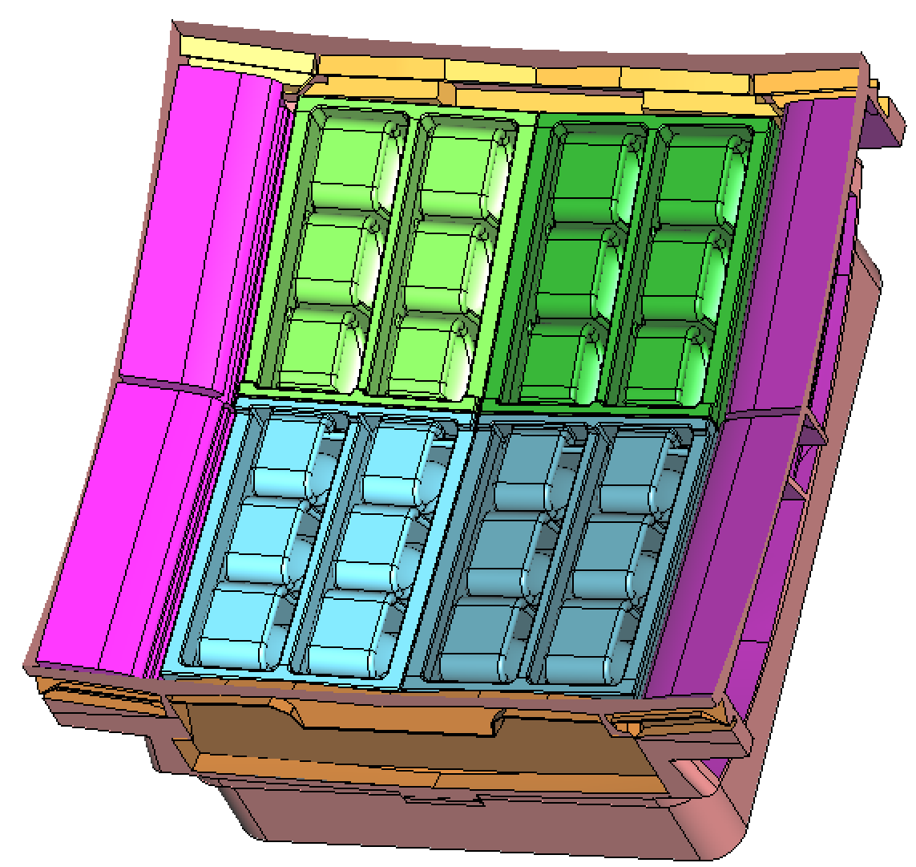
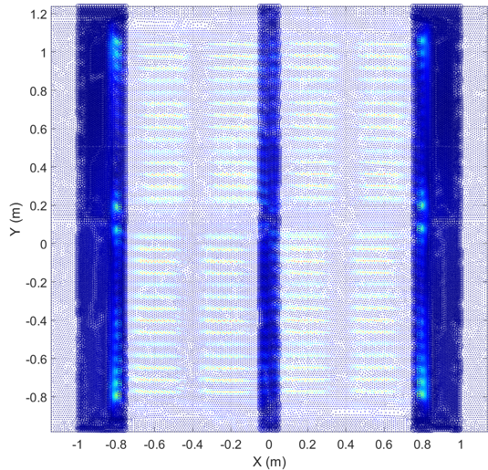
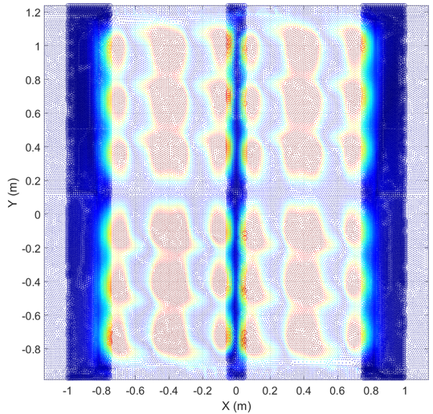
Variety of detailed CAD models
Several antenna versions, with/without surrounding port/plug cavity, with/without Four Port Junctions, etc.
[Milanesio, et al., RFPPC 2022]
[Milanesio, et al., NF 2023]
Recently, comparisons with / without Faraday Screen

Slide 29
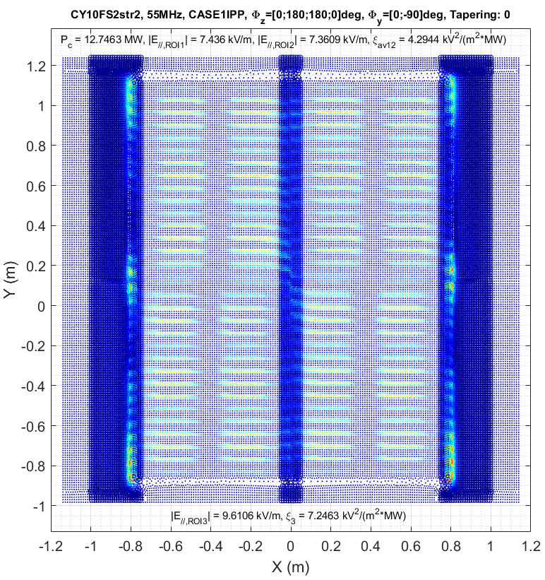
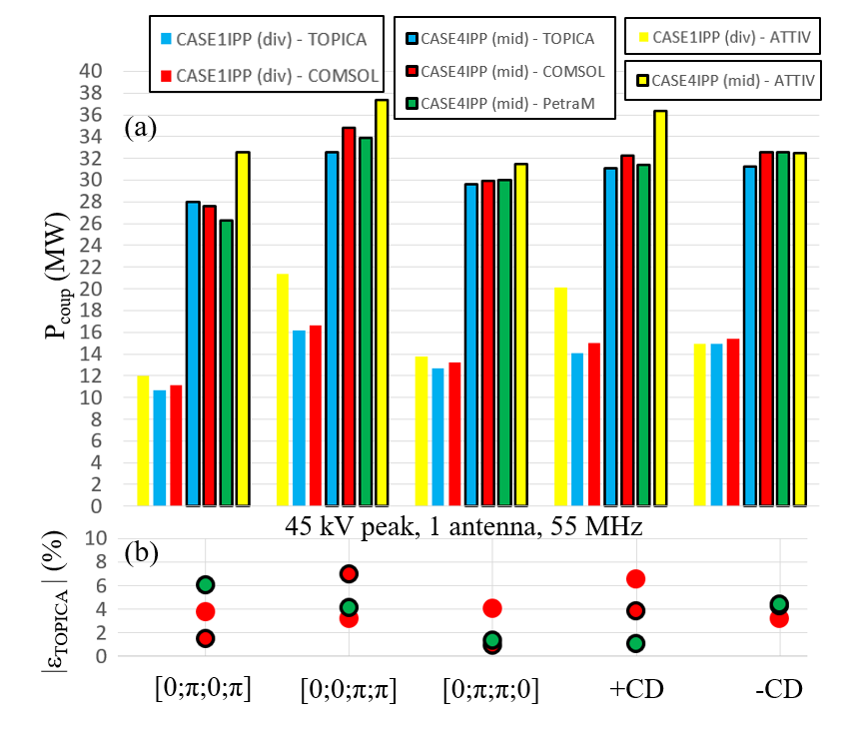
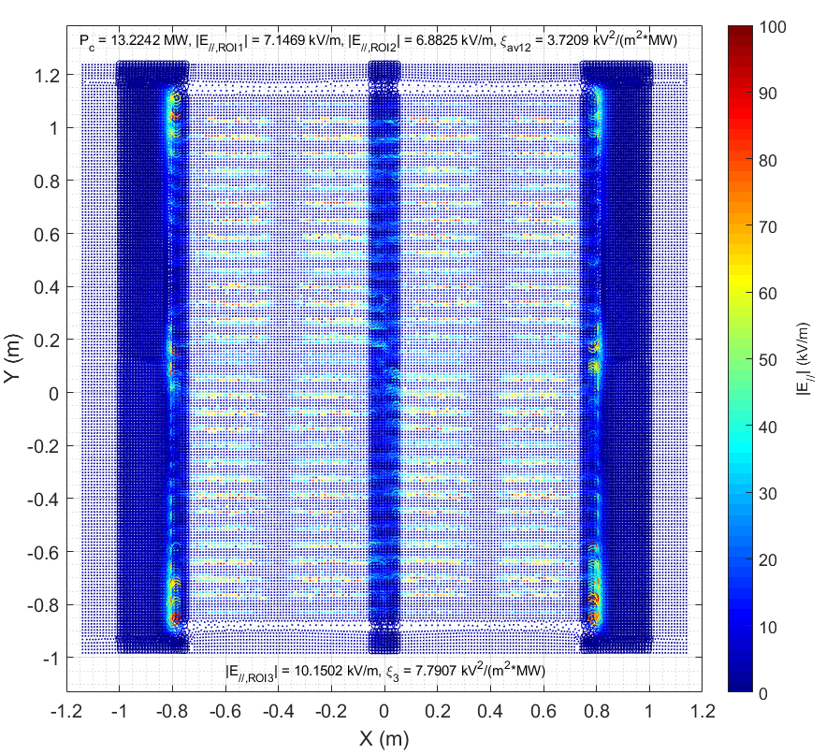
Robust benchmarks
Agreement on coupled power, E-fields, S & Z matrices, etc.
TOPICA
COMSOL

Slide 30
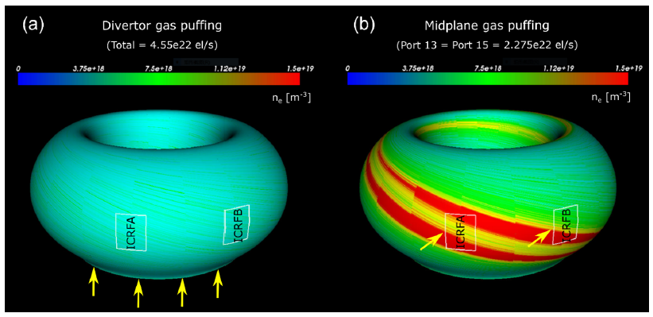
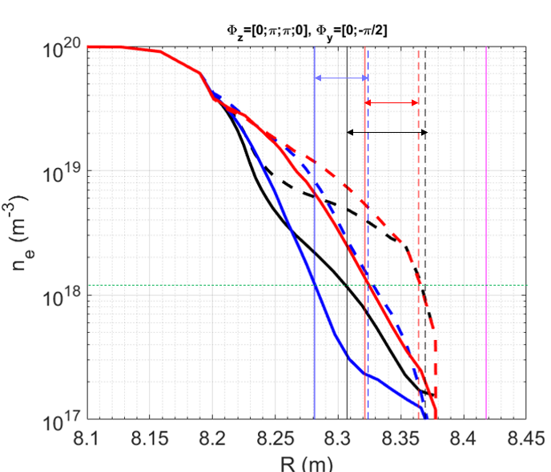
Modelling for local gas injection with validated tools
Modelling using EMC3-EIRENE, following by RF coupling modelling (ATT II, ATT IV, TOPICA, COMSOL, Petra-M).
For all scenarios, local GI moves cut-off density towards the antenna by several cm.
Straps
[W. Zhang, et al, NF 2023]

Slide 31
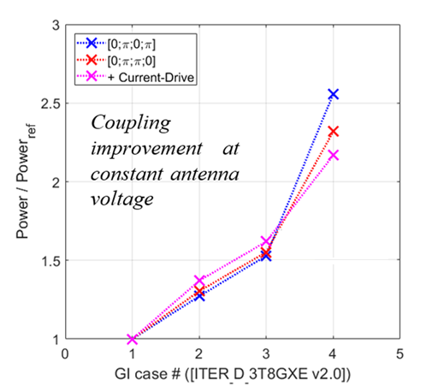
Boosting the coupling with local gas injection
×3
Power (MW)
# | Divertor [10²² el/s] | Mid P13 [10²² el/s] | Mid P15 [10²² el/s] | Total [10²² el/s]
1 | 4.55 | 0 | 0 | 4.55
2 | 0 | 0.5625 | 0.5625 | 1.125
3 | 0 | 1.125 | 1.125 | 2.25
4 | 0 | 2.275 | 2.275 | 4.55
[W. Zhang, et al, NF 2023]

Slide 32
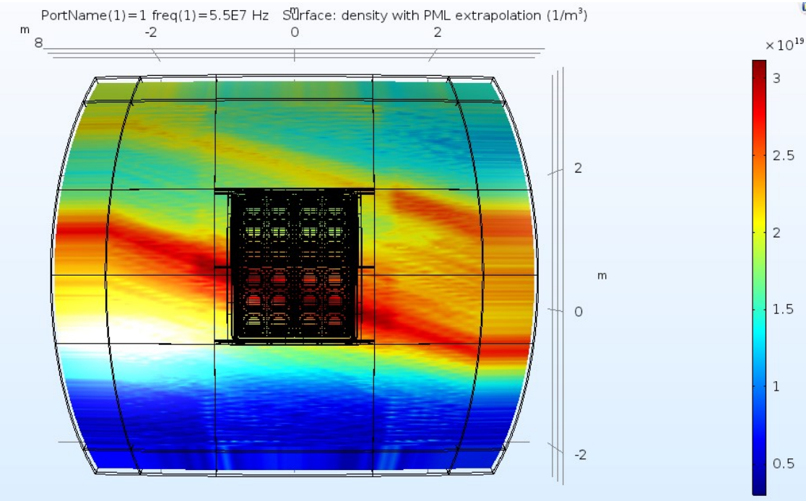
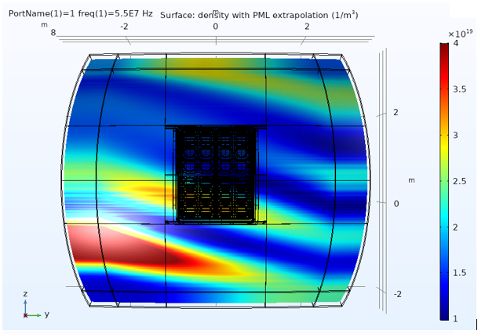

Step forward in modelling capabilities
Example: modelling with 3D detailed geometries and 3D plasmas.
COMSOL (RAPLICASOL) modelling
PMLs
n_{e}
n_{e}
Local midplane gas injection
PMLs
ELM, N=1:9, 4MJ, 15MA/5.3T, No RMP
[M. Becoulet, IAEA 2020]
PMLs
However most impact at n_{e,sep} for this case
PMLs
Acknowledgements:
M. Becoulet, CEA/IRFM, for the ELM density distributions.

Slide 33
Outline
ITER ICRF system under the new ITER Research Plan (IRP).
ICRH scenarios.
Ion Cyclotron Wall Conditioning (ICWC).
Coupling and local gas injection modelling.
ICRF specific sputtering predictions under W-wall.
Full system RF modelling.
Antenna RF and mechanical design activities.
Antenna protections and arc detection.
Prototyping activities.
Conclusion and timeline.

Slide 34

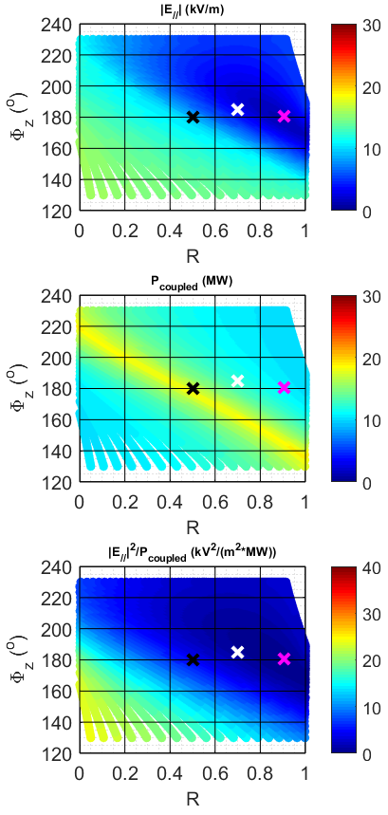
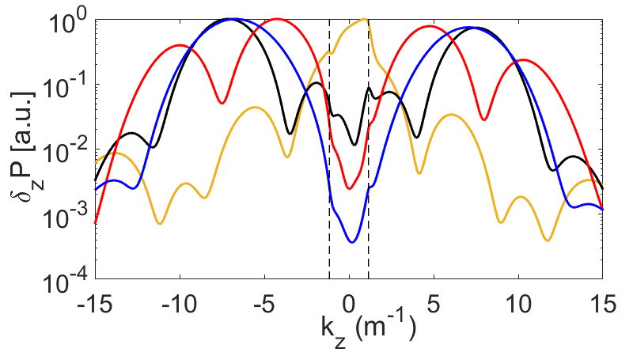
ICRF-specific sputtering in high-Z tokamaks
Continuous progress in increasing ICRF coupling & minimizing ICRF-specific sputtering, in particular with high Z wall: AUG & C-MOD.
Optimizations of both:
Array antennas geometry, &
Excitation laws (incl. tapering or apodization) [*].
<E//> [kV/m] @ surrounding PFC
[0;π;0;π]
3.8
9.6
1.3
-k₀
+k₀
ATTIV, Local gas injection
P_{cent}/P_{tot}
[*] “Radiation pattern” synthesis is common practice in antenna phased arrays; used for decades “outside nuclear fusion”. Now used in nuclear fusion (independently) to reduce ICRF-specific sputtering since first demonstration on AUG.

Slide 35
International effort following new ITER baseline
4 Work-Packages launched in 2023 with international community (large effort):
WP1: Empirical extrapolation or “0D quantification” with IPP-Garching.
WP2: Modelling on SSWICH2D with CEA & support from IPP-Garching.
WP3: 3D RF sheath modelling (Dielectric Layer Method, implemented in COMSOL) followed by GITR modelling with ORNL with support from Lodestar Research Corporation.
WP4: 3D RF sheath modelling on Petra-M by PPPL.

Slide 36
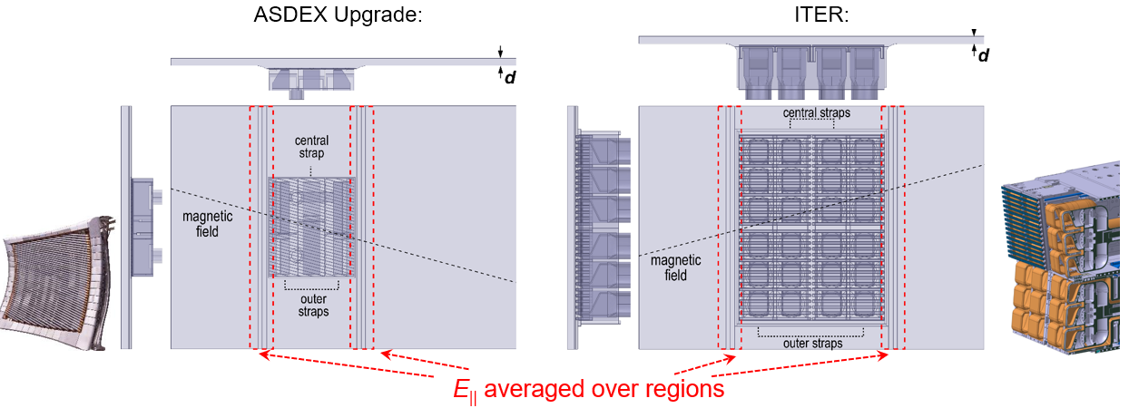
WP1 in a nutshell
Comparing AUG and ITER antennas:
[V. Bobkov, et al., PSI 2024]
Using HFSS with lossy dielectric as loading,.
Flat antenna models for AUG 3-strap and ITER.
Taken same boundary conditions, PFC shapes and radial position of straps.
Average <E||> over the whole height of calculation domain: conservative for ITER antenna.
Using results & typical values of sheath voltages from AUG 3-strap
→ Extrapolation of results to ITER antenna.

Slide 37
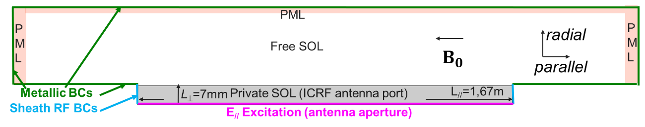
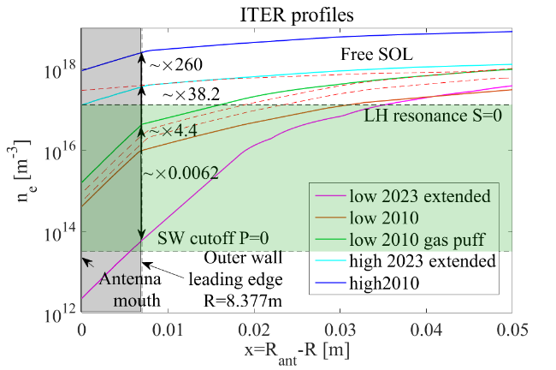
WP2 in a nutshell
[L. Colas, et al., PSI 2024]
Modelling using SSWICH-SW.
E// maps from TOPICA.
PML had to be adapted to propagative Slow Wave.
~30 runs, over large range of scenarios.
[L. Colas, et al., this conf.]

Slide 38
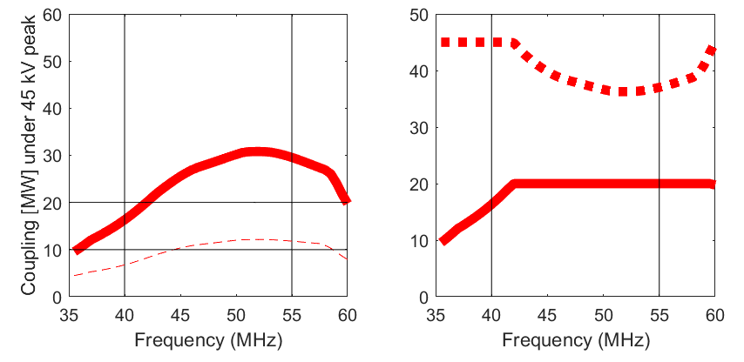


[W. Helou, et al., FEC 2023]
Outcome from WP1 and WP2
Modelling results for reference 15 MA full field DT H-mode and conservative estimates:
[0;π;π;0] in “Low 2010” conditions (Zone 1)
1 antenna
1 antenna
Φ_{W,wall} = 5.5×10²⁰ s⁻¹
V_{antenna} [kV peak]
Zone 2
Coupling [MW] at 45 kV peak
Zone 1
Local gas injection
P_{coupled} [MW]
Empiric extrapolation,
10-20 MW, [0;π;π;0]
[0;π;0;π]^{tapered} in “High 2010” conditions (Zone 2)
Empiric extrapolation,
10-20 MW, [0;π;0;π]^{tapered}
SSWICH
V_{antenna} [kV peak]
Low 2010
High 2023
High 2010
Coupling [MW] at 45 kV peak
P_{coupled} [MW]
WP1 & WP2 show compatibility with high power and low sputtering.
1 antenna
1 antenna

Slide 39

Some WP3 results
COMSOL modelling results with Dielectric Layer Method:
Large, local fields, due resonance cones & propagative Slow Wave.
Notes:
|E|
The first indication shows that the resulting ICRF-specific sputtering could still be moderate.
No indication of propagative slow wave impacting near-fields and ICRF-specific sputtering in AUG.
[V. Bobkov, et al., PSI 2024]
Recent results from WEST are in-line with results from AUG.
[R. Diab, et al., this conf.]

Slide 40



Some WP4 results
More distributed near fields.
P_{inc} = 10 MW.
n_{S=0} = 1 x 10¹⁷m⁻³.
Φ_{z}=[0;π;0;π].
Impact of tapering less noticeable.
max(V_{sh})
P_{central}/P_{outer}

Slide 41
IO strategy as per ICRF-specific in new IRP
WP1 & WP2
OR
WP3 & WP4
OR
Other
→ Fully in-line with IO strategy:
ICRF-specific sputtering extrapolation is complex task.
ITER ICRF system is to be tested / experimentally validated at reduced power (10 MW) at SRO following which decision on upgrade to full-power (20 MW) will be taken.

Slide 42
Outline
ITER ICRF system under the new ITER Research Plan (IRP).
ICRH scenarios.
Ion Cyclotron Wall Conditioning (ICWC).
Coupling and local gas injection modelling.
ICRF specific sputtering predictions under W-wall.
Full system RF modelling.
Antenna RF and mechanical design activities.
Antenna protections and arc detection.
Prototyping activities.
Conclusion and timeline.

Slide 43

The electric circuit of the ITER ICRF system
Antenna
Pre-match
(3-stub)
Phase-shifters
(based on hybrid couplers)
Decoupling / Beam-forming network
Main matching
Poloidal Splitters
(hybrid couplers) providing “load-resilience”
Variety of tuning parameters: stubs, capacitors, sources’ power amplitudes & phases.
Many of these parameters can be real-time controlled.

Slide 44

Static RF circuit simulations ongoing [1/2]
55MHz, [0;π;0;π], tapered, matched at Set7 (CASE4IPP)
[K. Saito, ITER_D_B5ZEW4 v1.0]
Perfect matching achieved.

Slide 45

Static RF circuit simulations ongoing [2/2]
55MHz, [0;π;0;π], tapered, mismatched, Set 1 (Low 2010)
[K. Saito, ITER_D_B5ZEW4 v1.0]
Notice load resilience (VSWR<2:1).

Slide 46


Matching algorithms development ongoing
Example of matching algorithm with:
[K. Saito, ITER_D_CHY9GQ v1.1]
Static stubs (ex. much less reduced risks of failure because of triboelectric aspects at the RF contacts).
Addition of matching capacitors in main matching.
Real-time controlled capacitors and frequency.

Slide 47
Outline
ITER ICRF system under the new ITER Research Plan (IRP).
ICRH scenarios.
Ion Cyclotron Wall Conditioning (ICWC).
Coupling and local gas injection modelling.
ICRF specific sputtering predictions under W-wall.
Full system RF modelling.
Antenna RF and mechanical design activities.
Antenna protections and arc detection.
Prototyping activities.
Conclusion and timeline.

Slide 48



Antenna RF calculation strategy
Antenna circuit portioned.
Component full-wave modelled.
Precise electric circuit extracted → voltage and current standing wave patterns extracted.
Power is raised until reaching V_{max}=45 kV peak.
Compliance of |E| ensured for each component at V_{max}.
Circuit optimized using iterations of hybrid circuit / full-wave calculations & interaction with multiphysics drivers (cooling, neutron shielding, space reservation, etc.).
State of the art numerical tools and regular benchmarks (independent tools & expert users).
[ITER_D_44M4QS v2.1]

Slide 49




Example of RF modelling results [1/2]
Standing Wave Pattern along a triplet feeding line.
Coupled power for V_{max}=45 kV peak.
FPJ
STS axis
Front Window
Plasma side
Click to play animation.
Notice: large VSWR, voltage nodes in vacuum.
[ITER_D_44M4QS v2.1]

Slide 50



Example of RF modelling results [2/2]
Integrated modelling covering: RF, electromechanical, thermomechanical, seismic, nuclear, 3D development & integration, etc.
Example: RF loss densities from detailed full-wave modelling campain → Input for thermo-mechanical calculations (considered: impact of material tempearture, surface roughness, safety factor, etc.).
log₁₀(δ²P) [W/m²] at 55 MHz
Service T-stubs inner conductors
[ITER_D_44M4QS v2.1]

Slide 51
Outline
ITER ICRF system under the new ITER Research Plan (IRP).
ICRH scenarios.
Ion Cyclotron Wall Conditioning (ICWC).
Coupling and local gas injection modelling.
ICRF specific sputtering predictions under W-wall.
Full system RF modelling.
Antenna RF and mechanical design activities.
Antenna protections and arc detection.
Prototyping activities.
Conclusion and timeline.

Slide 52



Protections by proper design: satisfying V_{max} & E_{max} specifications
ITER ICRF antennas designed considering:
V_{max}= 45 kV peak [51ICs476-R] & |E| < 2-3 kV/mm (depending on orientation and location) [51ICs477-R] such as not to arc.
Example 2
Example 1
45 kV peak
45 kV peak
[ITER_D_44M4QS v2.1]

Slide 53




Protections by proper design: corona rings for RF windows
IO designed Rear Window:
Corona rings
(protect triple-points)
|E| for 45 kV peak
[ITER_D_5R8LUL v2.2]

Slide 54
ITER ICRF Antenna Arc Detection & Protection [1/5]
[51ICs151-R] All RF components that are exposed to high RF voltage shall be continuously monitored by redundant fast arc detection systems that are based on different concepts.
[51ICs153-R] In case of arcing the concerned subsystem shall deliver a fast signal to switch off the RF power feeding the whole concerned antenna subsystem, or, selectively, the RF power feeding the arcing subsubsystem(s)
[51ICs459-R] Automatic protection against arcing in antennas, power loads, transmission and matching systems and power sources shall be included in the design.
[51ICs483-R] The antennas shall be protected against internal malfunctions including arcing
[51ICs489-R] Equipment shall be provided within the antenna subsystem to ensure the detection of RF arcs, and to enable appropriate protective action to be taken by other subsystems before the onset of arc damage to the antenna.
[51ICs823-R] In case of an arc detected in a high RF power IC H&CD system component (source, main transmission line, matching circuit, antenna), the associated antenna sub-system shall automatically step back to the S4 state; the RF power shall be cut off in less than 10 µs (microseconds), in order to prevent a large amount of energy being delivered to the arc. The system shall automatically try to recover to the S5 state after an interruption time. The RF power interruption duration shall be adjustable (typically tens of ms), as well as the number of trips before definitive RF power cut off.
[ITER_D_28B33K - SRD-51 (ICH&CD) from DOORS]

Slide 55
ITER ICRF Antenna Arc Detection & Protection [2/5]
[2024_11_27-28 _ ITER ICRF Antenna Arc Detection and Protection Workshop 1, CQ2CVF]
# | Category | Detail | Comment
1 | Using RF signals at the operation frequency. | V_{ant,max} measurements (→ power limitation). | Extensive work with ERM under IO/20/CT/4300002178.
 |  | VSWR or |Γ|.
 |  | arg(Γ) and phase jumps.
 |  | Balance of line voltages, &/or currents, &/or Z.
 |  | Mix of RF signals (AWACS-like, voltage balances, etc.).
 |  | Scattering Matrix Arc Detection (SMAD).
2 | Plug/port cavity fields monitoring. |  | Extensive work with ERM under IO/20/CT/4300002178
3 | Optical Arc Detection
Likely only for the antenna prototype
(no probes in vacuum for the full antenna).
Likely only during installation of antenna in torus.
[F. Louche, et al., this conf.]
[A. Krivska, et al. this conf.]
In vacuum: likely only for the antenna prototype module.

Slide 56
ITER ICRF Antenna Arc Detection & Protection [3/5]
[2024_11_27-28 _ ITER ICRF Antenna Arc Detection and Protection Workshop 1, CQ2CVF]
# | Category | Detail | Comment
4 | Broadband Tx / Rx: active RADAR. | RADAR arc & impairment detection & localization (RAAD). | Extensive work with Politecnico di Torino under IO/24/CT/4300003010.
Work with Politecnico di Torino:
Proof of principle for ITER ICRF RAAD by:
Modelling → DONE.
Implementation and validation tests of a prototype RAAD module → Ongoing.
[S. Porporato, et al., this conf.]
[D. Milanesio, et al., this conf.]
[A] RAAD is able to detect arcs in less than 5 μs.
[B] RAAD shall protect the windows, and detect arcs at the low voltage regions in the antennas.
[C] RAAD is able to discriminate arcs from other events.
Proof of principle
Ongoing: implementation of framework for tests on AUG in 2026.

Slide 57

ITER ICRF Antenna Arc Detection & Protection [4/5]
[2024_11_27-28 _ ITER ICRF Antenna Arc Detection and Protection Workshop 1, CQ2CVF]
# | Category | Detail | Comment
5 | Broadband Rx: “passive” RADAR. | Sub (& Sup) Harmonic Arc Detection (SSHAD). | Feedback from: CEA-IRFM, AUG, JET. Politecnico di Torino under IO/24/CT/4300003010.
At the operation frequency, the generators and antennas are tuned; but they are mismatched at all other frequencies.
The system acts as a cavity with its own resonance frequencies F_{R,m}.
Arc: fast transient event → Broad spectrum → Excites cavity at F_{R,m}.
SHAD: measures ~comb pattern resulting from an arc.
Work ongoing with Politecnico di Torino for developing intelligent SSHAD to discriminates arcs from other events.
α1
α2
α5
α3
α6
α4
α7
α8
…
Ongoing: implementation of framework for tests on AUG in 2026.

Slide 58




ITER ICRF Antenna Arc Detection & Protection [5/5]
[2024_11_27-28 _ ITER ICRF Antenna Arc Detection and Protection Workshop 1, CQ2CVF]
# | Category | Detail | Comment
6 | Stray microwave radiation sensing. | Stray EC sensing (170 GHz). | Extensive work with Politecnico di Torino under IO/24/CT/4300003010
[P. Lamalle, ITER_D_5RUPCN]
Stray EC can penetrate in the ITER ICRF system and deposit power in the ceramics → Needs to be detected.
Work with Politecnico di Torino:
Parametric scans
(noise floor: ~-92 dB)
Experiments
FEKO
Ongoing: implementation of framework for tests on AUG in 2026.

Slide 59
Outline
ITER ICRF system under the new ITER Research Plan (IRP).
ICRH scenarios.
Ion Cyclotron Wall Conditioning (ICWC).
Coupling and local gas injection modelling.
ICRF specific sputtering predictions under W-wall.
Full system RF modelling.
Antenna RF and mechanical design activities.
Antenna protections and arc detection.
Prototyping activities.
Conclusion and timeline.

Slide 60



Prototype Antenna Module (PAM) in Port Plug Test Facility (PPTF)
Validate manufacturing, assembly, etc.
Lower power characterizations.
High CW power validation tests under maximal RF voltages and currents.
Retro-engineering if needed.
Tests at ~41 MHz and~54 MHz.
Tests of antenna protections.
Tests for Instrumentation & Control..
PPTF
RF source
(120 kW CW)
Pre-match

Slide 61




RF windows test articles
RF windows (Front Window and Rear Windows) progressing. Contracts with ASIPP, PMB and Vitzrotech.
Example for ASIPP windows: VNA tests for prototype RW Test Article, and Hipot tests.
Conservative
(1 atm air)
V_{max}
Next steps, tests at high voltage and high current, in CW.
I_{max}
  Modular design of the resonator:
  V_{max} and I_{max}.
  FW & RW.
[J.-M. Bernard, et al., this conf.]

Slide 62




RAAD, SSHAD and EC sensing + tests on AUG
RAAD:
EC sensing:
WR6.5 Sensing Aperture

Slide 63
Outline
ITER ICRF system under the new ITER Research Plan (IRP).
ICRH scenarios.
Ion Cyclotron Wall Conditioning (ICWC).
Coupling and local gas injection modelling.
ICRF specific sputtering predictions under W-wall.
Full system RF modelling.
Antenna RF and mechanical design activities.
Antenna protections and arc detection.
Prototyping activities.
Conclusion and timeline.

Slide 64

Conclusion and timeline
ITER ICRF CW high power RF system overviewed.
Large & complex system.
Good progress on all sub-systems. Design, R&D and prototyping ongoing.
Ready for high power operation in the tokamak
Baking
Delivery
Installation in Port Cell
Delivery of windows
+ Resonator commissioning
SAT in PPTF
RF tests in PPTF
RF tests
Delivery + Antenna FDR

Slide 65
Related contributions at RFPPC2025
Authors | Contribution
E. Lerche, et al. | Real-time estimates of the ICRF single-pass absorption for ITER.
S. Porporato, et al., | Radar arc and impairment detection and localization for the ITER ICRF antenna.
D. Milanesio, et al., | Full-wave modeling of arcs within the ITER ICRF antenna for usage in the simulations and design of the RADAR Arc Detection system.
F. Louche, et al., | Progress in the analysis of the cavity resonances in the ITER ICRF antenna port plug.
A. Krivska, et al., | Calculation of the magnetic field and its modal analysis in the port plug cavity of the ITER antenna.
L. Colas, et al., | Damping RF waves with low reflection in simulations of slab or curved magnetized plasma: parametrization, verification and implementation of Bermudez Perfectly Matched Layers.
R. Diab, et al., | Direct Measurement of ICRF-Enhanced Plasma Potentials Using Reciprocating Emissive Probes on the WEST tokamak.
J.-M. Bernard, et al., | Development of an actively cooled radio-frequency test bench for the ITER ICRF windows.
M. Schneider, et al., | Operation of the Electron Cyclotron system in the ITER new baseline.

